Slide 1
Applied Statistics in Healthcare
Multiple Linear Regression

Slide 2
Syllabus
Week 1
Purpose of the course
Introduction
Regression lines
Assumptions
Diagnostics
Week 2
Methodological issues
Variable selection
Assessment of model fit
Missing data
Interactions
Nonlinearty
Week 3
Weighted Least Squares Regression
Aggregated data
Data reduction
Model validation: Calibration and Discrimination
Additional topics: Extensions of the linear model.
Week 4
Case Study 1: Hypothesis testing, effect size measurement, and predictive modeling.
Predictive modeling: Maximum forced expiratory volume (breathing test).
Hypothesis testing and effect sizes: Very low birthweight.
Week 5
Case Study 2: Health economics, cost, and time.
Diagnostic cost model: Seriously ill hospitalized patients. SUPPORT (Study to Understand Prognoses Preferences Outcomes and Risks of Treatment).
Prognostic time model: Seriously ill hospitalized patients’ length of stay.
Week 6
Case Study 3: Intervention studies and causal models.
Intervention study: Covid 19 ICU bed utilization after the vaccine began.
Intervention study and Differences-in-Differences: Minimum wage laws and employment rates.

Slide 3
Purpose of the course
Provide supplemental analysis methods for your work

Slide 4
Purposes in learning regression
Help make better decisions, faster, with an all-in-one approach.
Increase accuracy by controlling for other competing causes.
Save resources: Make better use of the data we already have. Advanced methods work well on small samples like aggregated data.
Develop an expertise in identifying trends: Knowing a regression trend line allows us to better interpret a standard report’s results.
Learn how to risk adjust and do predictive modeling.
Learn concepts that are the foundation of all other regression types.
Identify group trends useful in telling us if medical centers are improving, getting worse, and all on the path to reaching our goals.

Slide 5
Motivation for multiple linear regression
There are 2 approaches in testing hypotheses : 1) Balance our sample on all important things and then test or 2) gather data on all important things, then balance mathematically when we test.
#1 is called an “experiment” and the 2nd approach is an “observational study”. Observational studies always work in health care. Experiments with randomization can be impractical or even unethical in health care.
Regression allows us to simultaneously test relationships. Otherwise, we would need to do separate tests.
It is important to note regression is a robust method that is not sensitive to small or moderate outliers and violations of assumptions. If you have the correct model, your regression estimates will likely be correct given adequate review, especially as your sample increases.

Slide 6
Advantages over multiple tests
There are various methods of statistical inference that allow you to examine the relationship between two or more variables.
For example, if we want to know the relationship between 2 continuous variables without considering cause and effect, a correlation will work. Or if you would like to compare the means of 2 or more categorical groups, t-tests or Analysis of Variance are good options..
But when we are interested in more than two variables and we want to predict the value of the dependent variable as a function of several independent variables, we should use multiple regression.
Multiple-regression methods can be very powerful because the independent variables can be either continuous or categorical, or a combination of both.
This allows us to control or adjust for other things (e.g., the intervention has a strong effect, even after making all things equal on age).
Doing multiple tests also increases our chances of a Type-I error (stating a statistically significant difference when there is not a difference).

Slide 7
Three reasons for doing regressions
Hypothesis testing: “We expect the group that received the intervention will have a lower readmissions rate”, “we expect the period after the vaccine to have a lower mortality rate”, etc.
Effect size estimation: We may want to know how much an effect has on an outcome. For example, what percentage of readmissions is reduced by an intervention? What are the cost savings from an intervention program?
Predictive modeling: We create predicted scores for individuals to assign care. For example, we may try to predict a patient’s chance of survival, length of stay, a child’s lung capacity, etc.

Slide 8
Book and data files
All located in “Files” from “Stats with Steve” team. See “References” in the appendix for citations.
Link to “Multiple Linear Regression” folder: https://sp-cloud.kp.org/:f:/s/StatswithSteve/EkwjvZ-4UnFOk1I3Ic3warkBam0w1HPRMQYJ4R2CI9RBaw?e=jSwtgJ
SAS files for the Motor Trend cars example: Regression Project.egp, Regression Program.sas, mtcars.dat, mt2.sas7bdat.
R data file: Course_Data.rdata.
R datasets: mtcars2 (Motor Trend cars), cardk (Card & Krueger study), a1 (aggregated Card & Krueger for graphing), FEV (Forced Expiratory Volume study), support3 (SUPPORT study), support3i (SUPPORT imputed data), lbw1_p (Very Low Birthweight study), cts_small (Covid Time Series).
Youtube link of the first session: https://youtu.be/SClwyjDEvoc
My homemade R Shiny App (GUI) available to do regression. You only need to be connected to the regular KP network:
Predictive Modeling and Global Sensitivity Analysis (kp.org)

Slide 9
Glossary
Regression: The process of defining an outcome by one or more predictive variables. For continuous outcomes, we often use the “ordinary least squares” method to calculate regression coefficients. Also referred to as linear or multiple linear regression.
Model: The set of variables used to explain the outcome of interest. For example, life expectancy might be modeled as: Years alive = Age + Gender + health status.
Coefficients: These are the regression weights used to calculate model predictions. For example, in a model that predicts weight, a height coefficient of 2 indicates that for every added inch in height, it adds 2 pounds to predicted weight.
“Y”: Outcome variable, response variable, or dependent variable.
“X”: Predictor variable(s), explanatory variable(s), or independent variable(s).
R-Squared (R^2, R2): The proportion of variance of the outcome accounted for by the predictors, model reliability. I.e., how well the trend line aligns to the actual data points.​ More alignment= higher R^2.
Confidence Interval: A range of the sampling distribution that a population values falls within, given a specified confidence level (e.g., 95%). Example: We are 95% confident the average age of clinic patients is between 59 and 71. If we sample 100 groups of clinic patients, we expect to see average ages of 59 - 71 in about 95 of the 100 sample groups.
Statistically significant: It refers to hypothesis testing when there is a large enough difference that we don’t expect is due to chance. The inverse of a confidence interval. For example, when the men’s mean blood pressure value falls outside of the confidence interval of the women’s group value, the difference is statistically significant.
P-value (p): The probability of a Type I error (incorrectly stating there is a difference when there isn’t one). This is the chance of us being wrong about seeing an important difference. Ranges: 0 to 1.0. When p < 0.05, we commonly call it “significant”.

Slide 10
Introduction
Overview and background

Slide 11
Multiple Linear Regression (Ordinary Least Squares)
Regression: Regressing the outcome on one (simple) or more predictors (multiple).
Linear: Refers to a line that best represents the association between the outcome and the predictor (Y ~ X).
Outcomes: In ordinary least squares, the outcome is continuous. These are variables with many values (e.g., age, length of stay, birthweight, cost, etc.). We can for practical purposes often treat ordinal outcomes as continuous. But a specific issue is that ordinal scores have ceiling effects because minimum and maximum scores apply (e.g., 1-10 scale). (Steyerberg, p. 54).

Slide 12
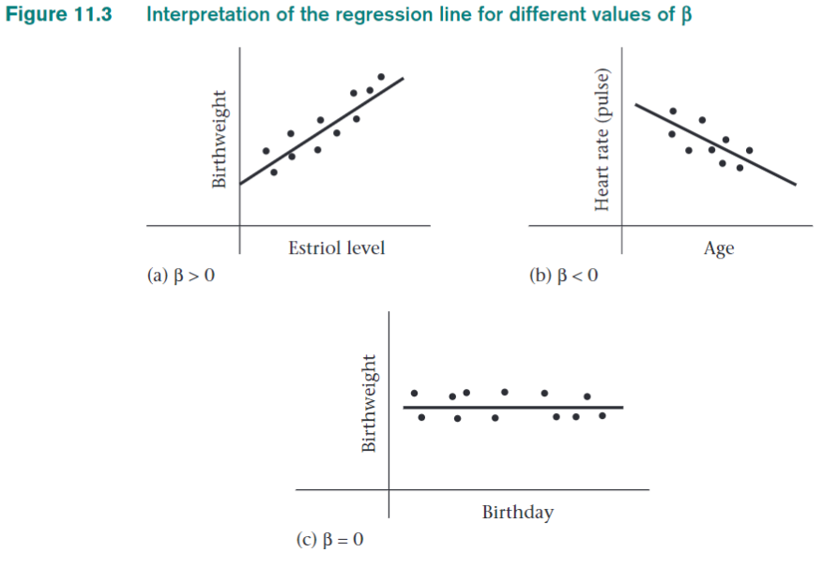
As mother's estriol levels increases, the average baby birthweight increases.
As baby ages get older, their heart rates slow down.
Y
X
Y axis= Outcome
X axis= Predictors
We graph trend lines, the bottom left corner is where both X and Y= 0.
Rosner, p. 430
There is no relationship between birthday and birthweight, the trend is flat.

Slide 13
Motor Trend cars, 1973-74: Data example
[ 1] | mpg (outcome Y) | Miles/(US) gallon
[ 2] | cyl | Number of cylinders
[ 3] | disp | Displacement (cu.in.)
[ 4] | hp | Gross horsepower
[ 5] | drat | Rear axle ratio
[ 6] | wt | Weight (1000 lbs)
[ 7] | qsec | 1/4 mile time
[ 8] | vs | Engine (0 = V-shaped, 1 = straight)
[ 9] | am | Transmission (0 = automatic, 1 = manual)
[10] | gear | Number of forward gears
[11] | carb | Number of carburetors

Slide 14
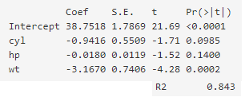
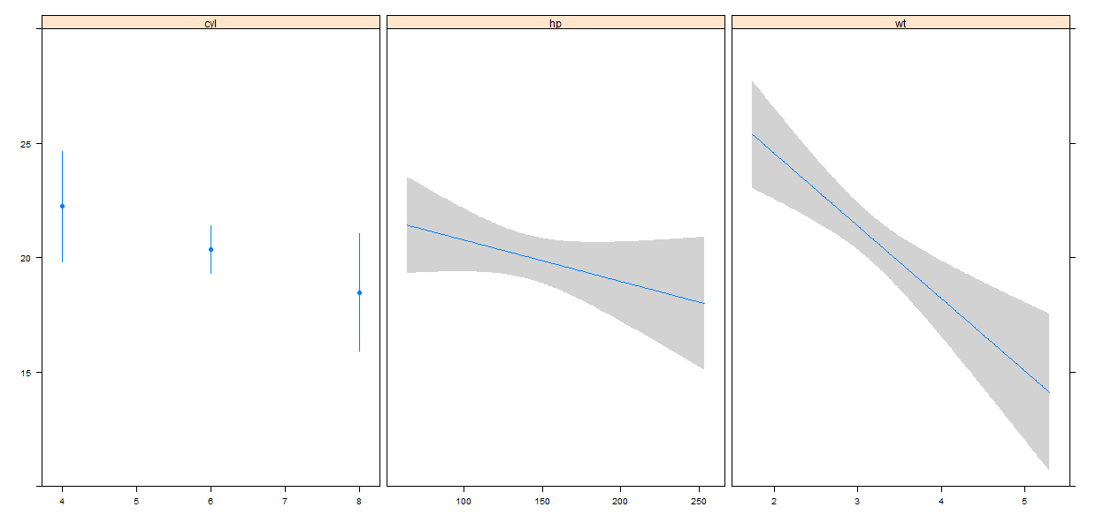
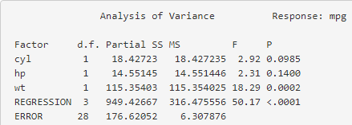
Background (1)
Routine output from a regression
Regression formula: MPG = 38.8 + -0.94*cyl + -.01*hp + -3.17*wt
Regressions uses both categorical and continuous predictors.
It is similar to combining correlations and group tests in one analysis.
R2= 0.843
= 949.4/
(949.4 + 176.6)
A significant model indicates at least 1 significant predictor

Slide 15
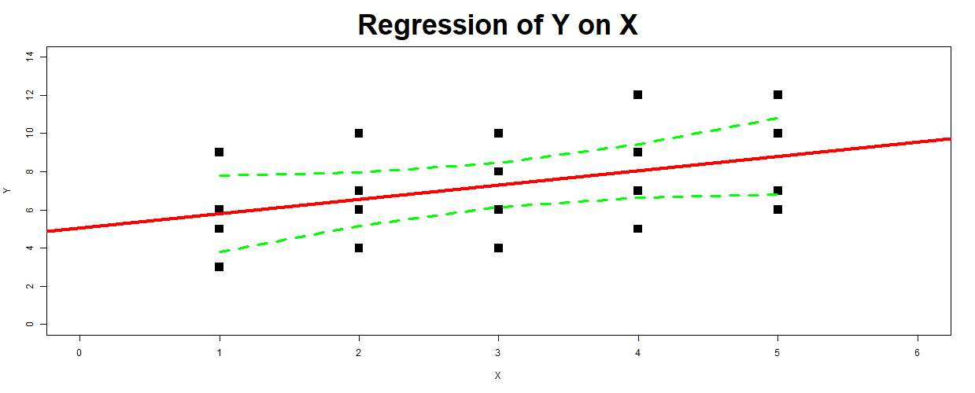
Background (2)
Another name for Ordinary Least Squares Regression is Simple or Multiple Linear Regression (“multiple” when there are >1 predictors).
A statistical formula calculates the path of a line that gives the least residual sum of squares. (i.e., the line falls in a spot between the data points of your predictor and outcome values with the least errors).
Regression line with 95% confidence intervals. This is a likely range had we many datasets instead of 1.
Knowing regression will help you identify significant trends by looking at lines in dashboards (e.g., a flat line is not ”significant”)
See Moore & McCabe (Chapter 10) and Appendix to read more about confidence and prediction intervals)

Slide 16
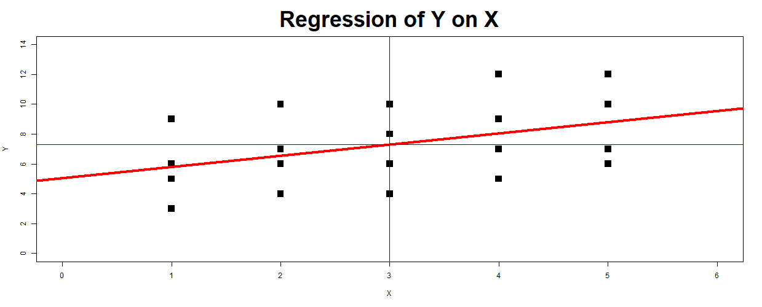
Background (3)
A “residual” is an error or the difference between a predicted score and the actual (observed) score.
Intercepts and slopes are used to draw any line. The intercept and slope are coefficients generated by a regression to create our trend line. For example, if the Intercept = 5.05 and B= 0.75, we predict Y= 7.3 when X=3 (5.05 + 0.75*3 = 5.05 + 2.25 = 7.3).
The blue lines intersect at the predicted score of 7.3 which is also the average Y score.
Residual
A regression attempts to predict the mean outcome Y.
Y = 7.3
Intercept

Slide 17
Background (4)
We can tell how well the line fits the data with R^2. R Squared (R2) indicates the proportion of variance of the outcome accounted for by the predictors (regression model reliability). The higher the R2, the more we can explain why values of Y differ.
A regression is similar to a correlation but also provides coefficients on incremental changes of 1 for continuous variables as well as for each level of categorical predictors (e.g., low, medium, high risk).

Slide 18
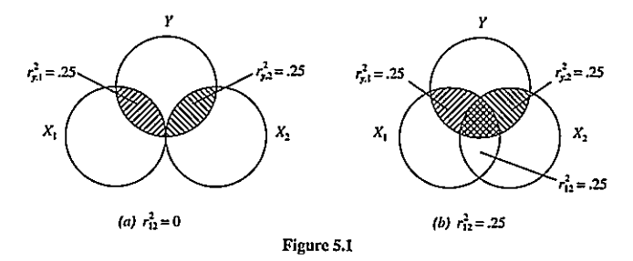
Background (5)
Multiple variables can be tested simultaneously in a regression, controlling for each variable’s impact and the correlation between predictors. We get more accurate results than testing each separately.
Figure 5.1: Left side has 2 uncorrelated predictors, R2=0.50. Right side has 2 correlated predictors, the overlap gives a lower R2=0.25.
The overlap in the diagram indicates there is redundant info in the predictors. But its still better to have both predictors.
Pedhazur, p. 97

Slide 19
Background (6)
Guidelines on R2.
Cohen (pp. 413-414) defines “middle-of-the-range” cutoffs for small, medium, and large R2 as 0.02, 0.13, and 0.26 for several predictors. Cohen points out that the R2 levels vary depending on the expected level of prediction in the subject matter (i.e., some outcomes are easier to predict while things involving human behavior are more difficult).
R2 means different things and in different situations. If we want to extrapolate a trend for the next future month, we should do so only if our R2 is 0.70 which is general cutoff for a high level in predictive modeling.
Although we might have a low R2 that indicates a low explanatory ability for predicting hospitalization costs of individual patients, the model could still accurately estimate the anticipated mean hospitalization costs of groups of children with the same characteristics (e.g., pneumonia). (Steyerberg, p. 54)
It is important to consider the context, for example, actuaries have looked favorably on prospective models with R2= 0.06 to predict future costs (Ash, 1989; Epstein & Cumella, 1988). The predictions for individuals wouldn’t be helpful but they could be very helpful for subgroups such as intervention groups, hospitals, and diagnosis groups. Models used routinely have R2 around 0.15 to 0.20. Prospective models are not expected to ever approach R2= 0.50 for some things because they can’t predict which specific individuals will experience acute illness or have large costs. But prospective models can identify the chronic problems that lead to large systematic differences in the future costs of groups (Iezzoni, pp. 245-246).
Another way to use R2 is to assess the potential use of risk adjusters. For example, the APACHE 2 was developed only to predict ICU deaths, it also works well in non-ICU populations and for length-of-stay (Iezzoni, p. 246). It has been validated in other settings.
Reducing the range in X to exclude extreme values can lead to a lower R2, partially due to the subsequent reduction in the variation in Y. Reducing the range in Y by excluding extreme values is unpredictable (see Iezzoni Figure 10.1, p. 247).

Slide 20
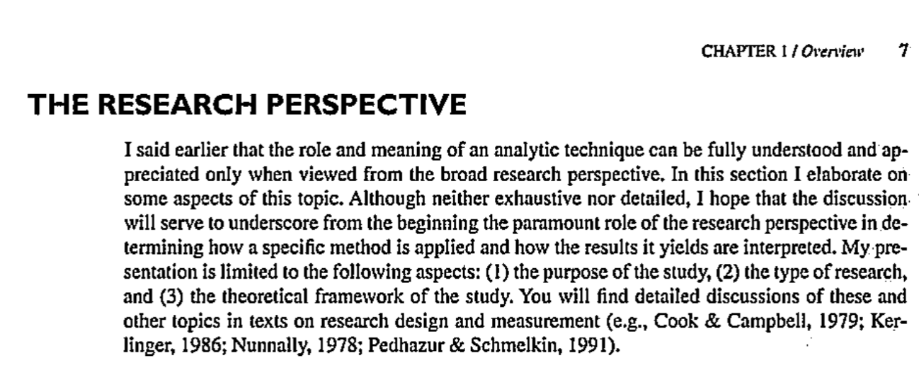
Research and Statistics
Regression wasn’t created in the field of research but it was a natural fit for observational studies where we test many things simultaneously (e.g., age, gender, health status). It really helps to research an outcome to design a good study.
Shadish, Cook, & Campbell

Slide 21
Research and Statistics
The best way to get a more powerful model is to research the topic to find the most important predictors.
For example, in Doll & Hill’s 1950 study that linked lung cancer to smoking, the other prevailing theory on the cause was automobile pollution.
Imagine developing a lung cancer model today without including smoking.

Slide 22
Health economic outcomes
Two outcomes we often consider are length of stay and cost.
Both outcomes are usually non-normally distributed.
That’s because we have special cases of $0 costs or it’s positively skewed because some patients have very high costs.
We might consider the median as a good descriptor of the outcome.
However, we are always interested in the mean from the economic perspective. We can identify high-cost patients or groups.
Models with an R2 that is too low (R2 < 0.60-0.70, depends on Y) to predict hospitalization costs (or LOS) of individual patients can still accurately estimate the average costs of groups of patients with the same characteristics. (Steyerberg, p. 54)

Slide 23
How to work with skewed cost outcomes
Outliers have a direct impact in the formulas we use in regression. The goal of OLS is to minimize squared errors. Being off by $10,000 isn’t a big deal if it is spread over 10 patients at $1,000 each. But if just 1 patient is an outlier by going over the predicted cost by $10,000, the associated squared error is 10 times larger than it would be for 10 patients: 10000^2 / (1000^2 * 10) = 10
These extreme scores can substantially distort predictions for cases with low or moderate values.
Various options for dealing with outlier:
Trimming: Dropping cases. Medicare drops values that are > 3 SDs on a log scale. Be careful, R2 can be effected.
Topcoding: This replaces high outliers with some maximum value (e.g., $20,000= $10,000). This can improve R2 but it won’t cover full range of $ values, won’t be as descriptive. Iezzoni prefers “topcoding” over “trimming” because the most expensive cases are usually important. Trimming and topcoding can underestimate predicted costs and lead too high observed:expected ratios.
Winsorizing: Drops equal amounts of low and high cases (e.g., 5 lowest values replaced with maximum of the 6th lowest and 5 highest replaced with 6th highest). By Dixon and Tukey, 1968.
Log transformations: The outcome is replaced with a natural log. With their more normal distribution, transformed data more closely conform to the assumptions of OLS modeling. Transforming continuous outcome variables is more appropriate when the goal is to identify statistically significant predictors of the outcome (to better meet the assumption underlying the statistical tests). However, when the goal is to predict the value of the dependent variable, such transformations are less useful. It requires “back transformations” of the predicted values and “smearing” to adjust for the bias in retransforming predictions. But there are still some issues with the precision in predicted cost values. R2 values tend to be higher with untransformed outcomes
General Linear models (GLM): Poisson and Ordinal logistic. Or Quantile regression.
Cox proportional hazards model: Highly effective, this semi-parametric model treats costs as a rank order (e.g., if the 2nd highest cost is $10,000 and the highest is $500,000, they still have the same rank of 2 and 1. See Dudley & Harrell (1993)
Models having the smallest Mean Absolute Deviation (MAD). This is the average of absolute differences in values of [Observed Y – Predicted Y]. In general, models with higher R2 values have lower MADs.
“Lumley (2002) used simulations to show that, with large datasets, OLS generally handles nonnormally distributed data well despite its underlying assumptions about normality.” (Iezzoni, p. 245)

Slide 24
Steps in Regression
Research/study design
Data collection: Don’t categorize continuous predictors when possible, get wide distributions. Use well defined groups.
Descriptive statistics, examine outcome means by quartiles or categories.
Variable selection to define the model.
Run and assess the model.
Diagnostics and revisions (if needed).
Interpret results.
Make recommendations.

Slide 25
Regression strategies to improve the model
Use the literature and clinical expertise to create your models. This helps with “omitted variable bias” and inaccurate coefficients due to them representing other correlated variables that are not in the model (e.g., smoking or drinking).
Limiting the number of predictors to the most relevant will reduce “overfitting” (model performance over-inflated due to chance because of too many predictors, performs poorly on future data).
Relax assumptions when relevant to get more accurate results.
Nonlinear effects, interactions, data reduction, and imputation can help improve the accuracy of the results.
Interactions don’t always replicate in future work so base it on theory.
Control for known risk adjusters like age, gender, health status, comorbidities, patient demographics, attitudes, etc.

Slide 26
Regression lines
Understanding trends

Slide 27
Understanding regression lines
Regression lines are based on 2 primary components: 1) The regression trend and 2) the residuals.
How well we can trust the trend is determined by the ratio of the regression-to-residual.
The bigger the ratio (regression:residual), the more accurate the results.
Generally, a good-fitting regression line will have regression components large in absolute value relative to the residual components, whereas the opposite is true for poor-fitting regression lines.

Slide 28
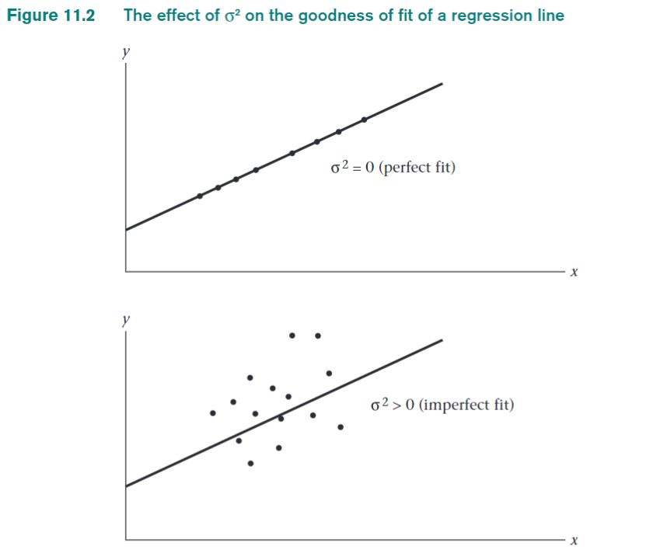
To the right are 2 examples of how well a regression line fits the data. The top half represents a perfect fit. The data points all fall on the line. This is something that is not expected to occur except on things such as the relationship between pounds and kilograms or inches and centimeters, very small samples, etc.
The bottom half represents an “imperfect” fit (variance > 0). Imperfect in the mathematical sense because the data points are scattered around the line. This happens frequently and the trend line still provides helpful information. Rosner, P. 430.

Slide 29
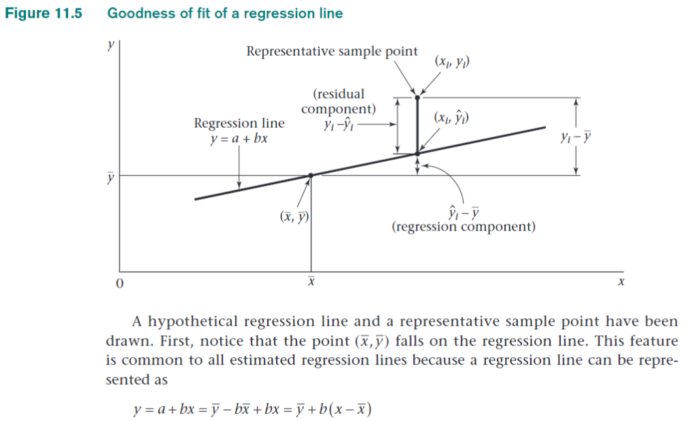
The point that intersects at the mean of X and the mean of Y must always fall on the estimated regression line.
Rosner, p. 435

Slide 30
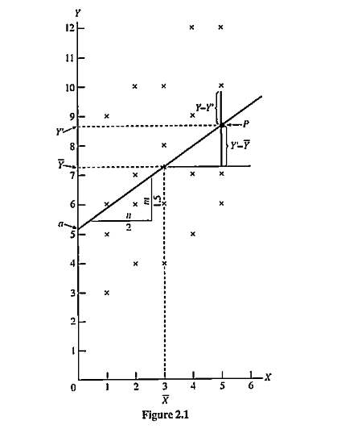
Graphic depiction of regression analysis (Pedhazur, p.24)
Some of the actual data
How we define the outcome: Y = a + bx + residual
Y – Y’ = 10 – 8.8= 1.2= Residual
Regression line
Y’ =Predicted outcome
Y’-Y mean = Deviation due to regression = 8.8 - 7.3= 1.5
Mean outcome Y = 7.3
“a” = Intercept = 7.3 – (0.75*3) = 5.05
Where Y=0 is intercepted by the regression line
“b” = Slope = m/n= 1.5/2 = 0.75
The slope is the change in Y we expect from each increase of 1 in X. Slopes can increase Y’ as above or decrease it in other data.
Predicted scores. We’ll use the formula we derived from the regression analysis to predict Y scores, Y = a + b*X .
When X = 3:
Y’ = 5.05 + 0.75*3 = 7.3
Y’ = 5.05 + 2.25 = 7.3
When X = 5:
Y’ = 5.05 + 0.75*5 = 8.8
Y’ = 5.05 + 3.75 = 8.8
Mean predictor X= 3

Slide 31
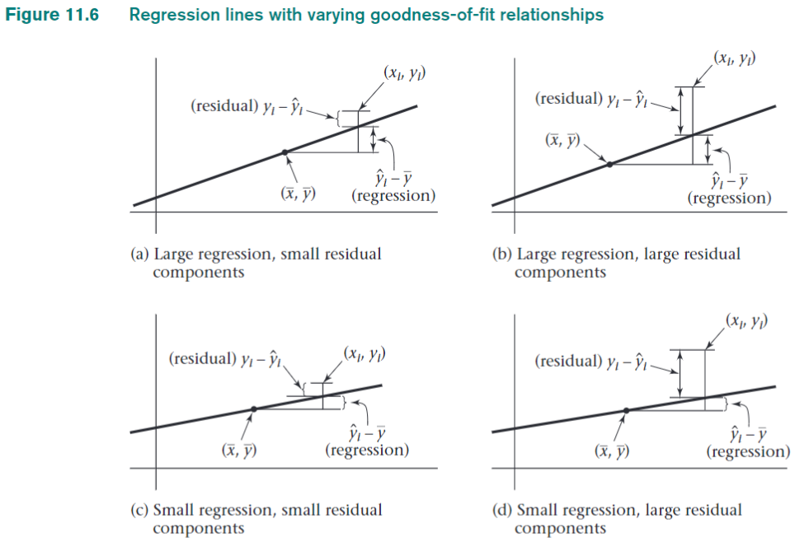
Some typical situations are shown in Figure 11.6.
The best-fitting regression line is depicted in Figure 11.6a, with large regression components and small residual components.
The worst-fitting regression line is depicted in Figure 11.6d, which has small regression components and large residual components.
Intermediate situations for goodness of fit are shown in Figures 11.6b and 11.6c.
How can the plots in Figure 11.6 be quantified? One strategy is to square the deviations about the mean, sum them up over all points, and decompose this sum of squares into regression and residual components
Rosner

Slide 32
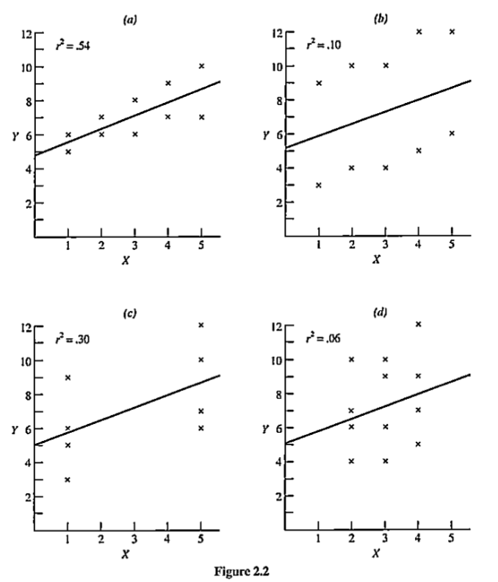
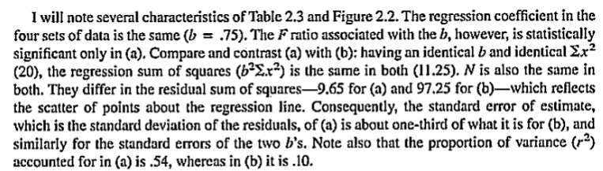
To the right are 4 identical regression coefficients (b= 0.75) that have 4 different performance values. The best performing model is “a” because the points are scattered closer to the line along the values of X.
Model C has a higher R2 than Model D because the extreme values (X=1,5) produce larger regression components and smaller residuals than Model D’s middle values (X=2,3,4). And gives a smaller standard error of the regression coefficient that gives a lower p-value (more significance). Beware of the effect of outliers that inflates the importance of results.
Pedhazur, Figure 2.2

Slide 33
Example of the relationship between regression coefficients, R2, sum of squares of regression
This is the “sum of squares of the regression” in the R2 formula:
(0.70 * Sum of cross product X1) + (0.59 * SCP X2) = 101.05
Bigger coefficients indicate a steeper slope. If we reduce the strength of the coefficients, the SS regression gets smaller.
(0.20 * SCP X1) + (0.20 * SCP X2) = 30.71
SCP X1 and SCP X2 make sense, the biggest product of Y*X happens when Y and X have the highest values. We see this when X and Y are highly correlated. This is then multiplied by the regression coefficient. If it is a strong effect, it makes the SS Reg even bigger.
So if we see X and Y values change together and our coefficient gets bigger, this leads to a higher R2

Slide 34
Example (continued)
Because of the formula, the point where the mean of predictor X and the mean of outcome Y meet must always be on the regression line. Or if you substitute the mean of X into the formula, this gives you the same intersection point (X, a + BX).
For predictions, we can ask how accurate is this estimate? The answer to this question depends on whether we are making predictions for one specific person or for the mean value of all persons in a group. Predictions for groups are generally more accurate than for specific persons.

Slide 35
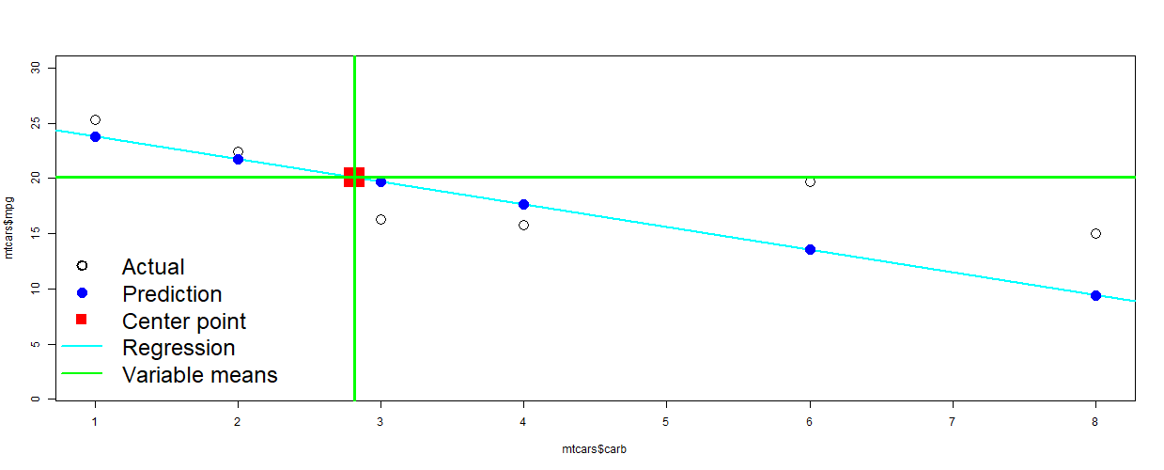
Trend lines always include the point where the means of the outcome and the continuous predictor variable intersect (red square below) in multiple linear regression.
We can often hand draw regression lines in small samples knowing the mean of the predictor and outcome are on the line.

Slide 36
Assumptions
We consider our conclusions are valid when the regression assumptions are generally met. And we cover how we deal with violation of assumptions. See Pedhazur (Chapter 3), Rosner (Chapter 11) to read more.

Slide 37
Ordinary Least Squares Assumptions
Linearity: The relationships between the predictors and the outcome variable is linear. This assumption can be relaxed with the use of nonlinear regression terms, Y = A + B + B^2.
Additivity: The impact of different covariates is additive, Y = A + B1 + B2. This assumption can be relaxed by using interactions, Y = A + B1 * B2.
Independence: The errors associated with one observation are not correlated with the errors of any other observation.
Normality: Errors are normally distributed. We can observe with histograms.
Homogeneity of variance (homoscedasticity): The error variance should be constant across levels of X. If not, you have heteroscedasticity.
Model specification: The model is specified correctly. This is based on your judgement.

Slide 38
Rosner’s notes on normality and independence assumptions
The normality assumption is most important in small samples. In large samples, an analog to the central-limit theorem can be used to establish the unbiasedness of b as an estimator of β and the appropriateness of test of significance concerning β (F and t tests for simple linear regression), or formulas for confidence-interval width of β, even if the error terms are not normally distributed (Rosner, p. 451). In other words, the coefficient estimates are more accurate as the sample gets larger.
The independence assumption (assumption 3) is important to establish the validity of p-values and confidence-interval width from simple linear regression. Specifically, if multiple data points from the same individual are used in fitting a regression line, then p-values will generally be too low, and confidence-interval width will generally be too narrow using standard methods of regression analysis (which assume independence).

Slide 39
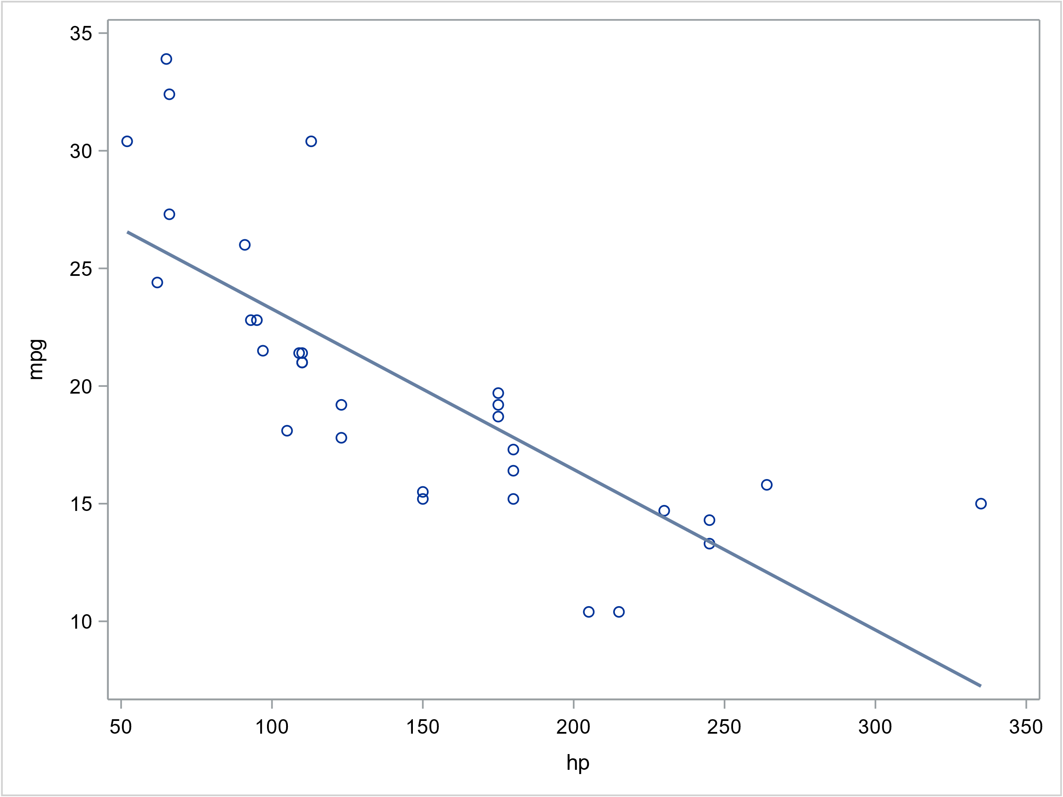
Assumption 1: Linearity (linear trend between outcome and predictor). Model: mpg ~ hp
The scatterplot with the regression line looks mostly linear.
Regression is a robust method which means it tends to give very accurate estimates when outliers are present. These values may suggest a nonlinear fit may be more reasonable. If so, we can “relax the linearity assumption” and include a nonlinear fit.

Slide 40
Assumption 2: Additivity (the regression equation follow the form Y= a + bx)
The model meets the assumption if it is specified as Y = a + bx.
There are times when it is better to relax the additivity assumption. For example, you may want to fit an interaction between age (X1) and gender (X2), the interaction (nonadditive) model is Y= a + b1x * b2x.

Slide 41
Assumption 3: Independence (the observations are independent of each other).
Independence is met if observations are not correlated with each other due to sampling.
For example, if a respondent has 5 rows of data or if groups of cases have many rows of data, estimates will be inaccurate because the data is dominated by their responses.
The correlation between rows of data is called autocorrelation.
If there is random sampling, you can assume the independence assumption is met. If not, a common option is to use “robust standard errors”, double standard errors of coefficients like “time”, set a lower alpha level (p<0.01) to indicate significance, or use a “design effect” (Rosner, p. 675) to get more accurate results.

Slide 42
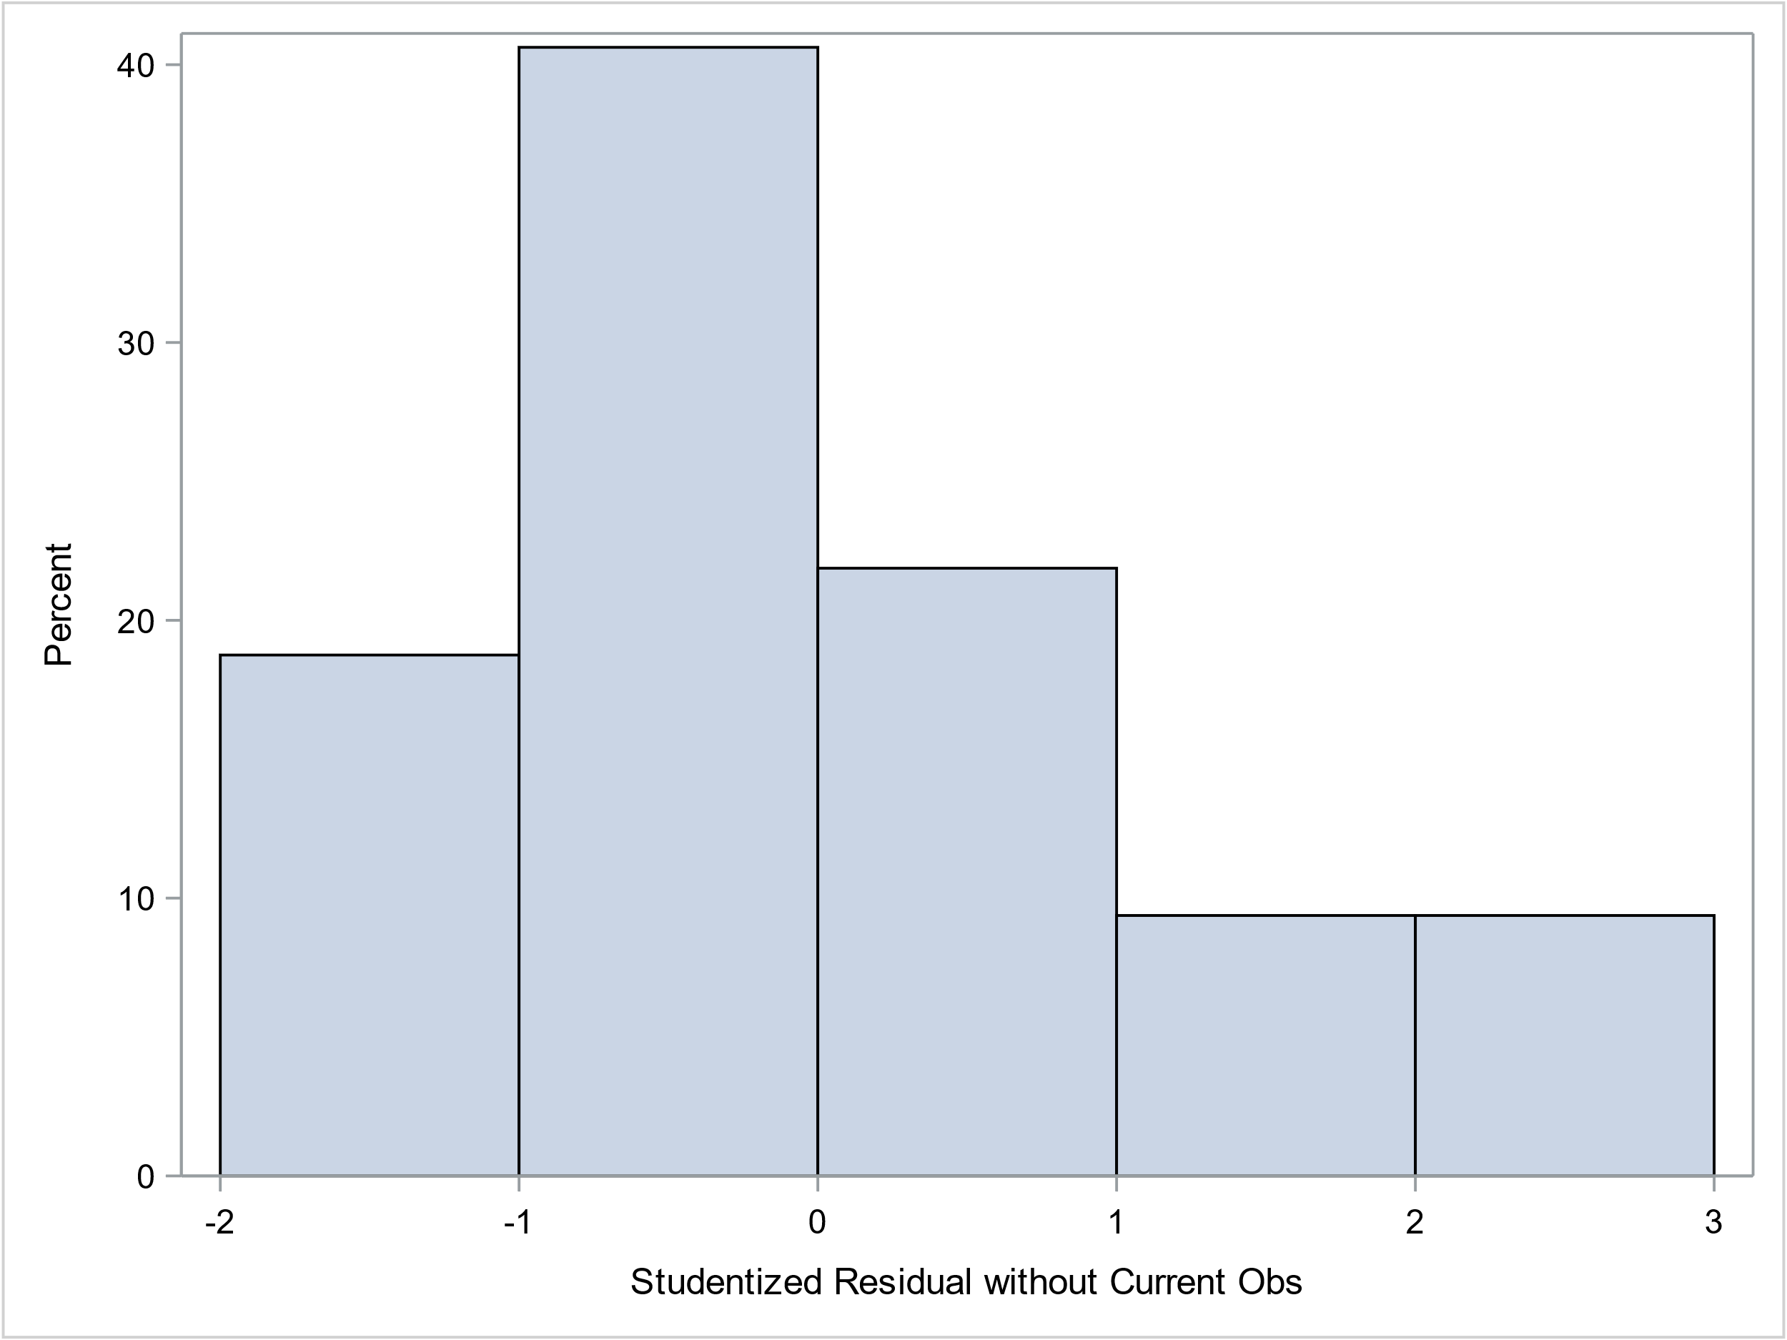
Assumption 4: Normality (normally distributed residuals). Model: mpg ~ hp
This SAS histogram lets us visually see the distribution of residuals. This looks mostly normal so we will consider the assumption of normality met.
Normality is less of a concern is large samples.

Slide 43
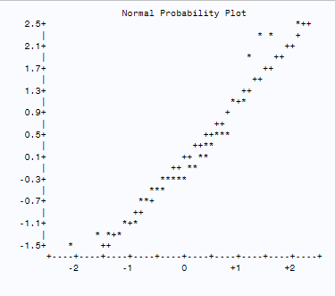
Assumption 4: Normality (normally distributed residuals). Model: mpg ~ hp
The qq plot shows the quantiles of a variable against the quantiles of a normal distribution. We see some non-normality in both tails, the highest and lowest ends of the residuals. However, the differences look small and the histogram appears normal too.

Slide 44
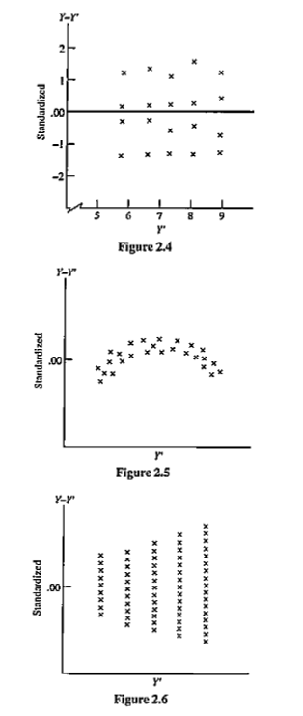
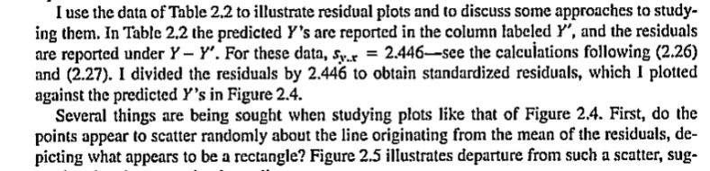
Assumption 5: Homoscedasticity Model: mpg ~ hp
The graph patterns suggest heteroscedasticity.
We can use weighted least squares regression
when the assumption is violated.
Pedhazur, Figure 2.6

Slide 45
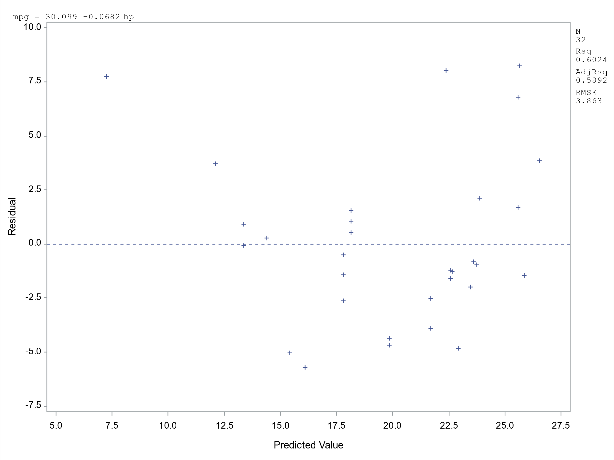
Assumption 5: Homoscedasticity (equal residual variance across X levels). Model: mpg ~ hp
By plotting the studentized residual by the predicted values, we can check if there are trends in the residuals that would suggest we have heteroscedasticity.
We see a random pattern that suggests we have met the homoscedasticity assumption.

Slide 46
Assumption 6: Model specification (Use the correct predictors). Model: mpg = hp + wt
Are the correct predictors in the model?
Use theory, research, and clinical expertise to determine what predictors should be used in the model.
“Omitted variable bias” happens when we don’t include all important predictors in a model.
Consider if interactions and/or non-linear terms should be included.

Slide 47
Diagnostics
Checking model assumptions and making model revisions. See Pedhazur, Chapter 3 to read more.

Slide 48
Identify outliers and influential observations
Some observations, especially in small samples, may unequally influence regression coefficients because of their extreme values in Y and/or X.
Outliers may have impact on linearity and normality assumptions.
There are various approaches to identifying outliers such as examining residuals and studentized residuals

Slide 49
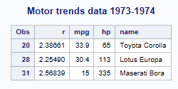
Examine outliers using studentized residuals
We can identify outliers from the studentized residuals. We’ll use a cutoff of >2 and < -2. We examine this data to see if these cases should be kept in the data as well our judgement if these cases are representative of the sample we are trying to make inferences from.
Overperforming
The residuals don’t seem extreme and because of our low sample size, we will keep the cases in. Plus, their unique values may provide us more information on what we are studying
Another way to identify outliers is to calculate the Inter-Quartile Range (IQR), multiply it by 1.5. We can then set a cutoff of 1.5*IQR above and below our 3rd and 1st quartiles.
Underperforming

Slide 50
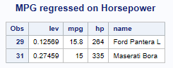
Examine “leverage” for influential observations
Look at leverage to identify observations that will have potential great influence on coefficients.
A regression line can be over-influenced by a single data point, especially in small samples. This could lead to the wrong regression line, especially if the X and Y values are outliers (low or high end).
Leverage greater than (2k+2)/n is considered high. k= number of predictors, n= number of observations.
Here, with 1 predictor and n=32, (2*1+2)/32= .125.

Slide 51
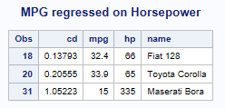
Examine Cook’s D for influential observations
We'll look at Cook’s D, an overall measures of influence.
The general cut-off point is > 4/n, here 4/32 = 0.125.

Slide 52
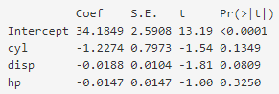
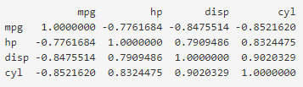
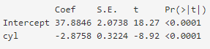
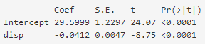
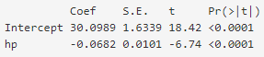
Collinearity: High correlation between predictors that can negatively effect results
Correlations. The 3 predictors and MPG outcome have high correlations.
The coefficients are reasonable but all S.E.s have increased thereby making all predictors non-significant even though we know they are significant.
We can compare how coefficients and test statistics differ in the full model compared to each single predictor separately in the “crude model”.
Using the model for hypothesis testing and effect size estimation is problematic for audiences when there is collinearity but it is less of a concern for predictive modeling.

Slide 53
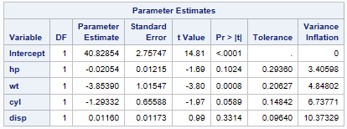
Test for Collinearity: Variance Inflation Factor and Tolerance
A multiple regression was performed on 4 predictors. That are correlated. Common cutoffs were used for VIF (> 10) and tolerance (< 0.10). Engine displacement and engine cylinders show some signs of collinearity. Data reduction should help.
A problem that we have is too many variables measuring the same thing, engine size. The number of cylinders and displacement tells us how much fuel flows through a car. They have the highest VIF. Removing either disp or cyl will help.

Slide 54
Methodological issues
Issues that can make the regression results less reliable and their solutions. To read more, see Harrell book (Chapter 4).

Slide 55
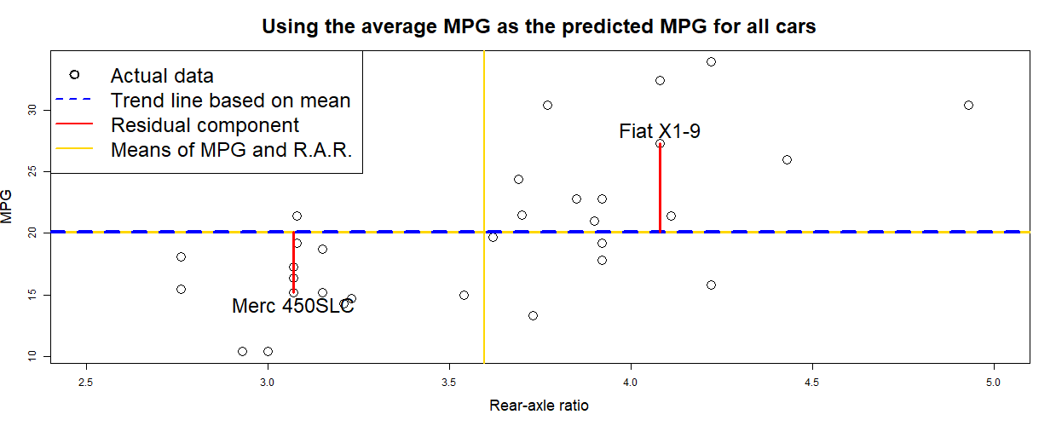
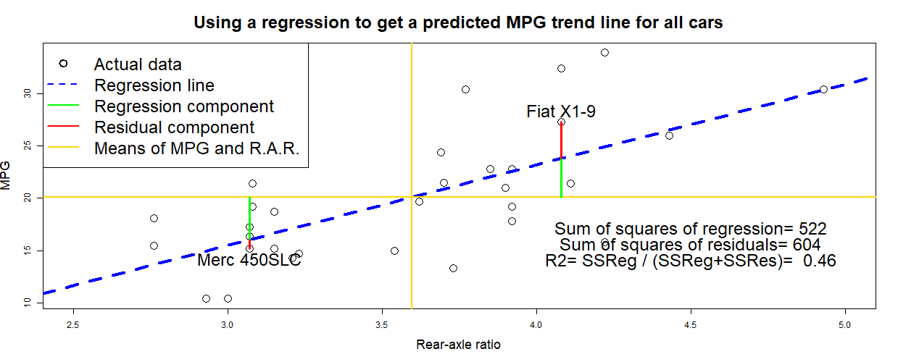
Review of regression
The red lines are the errors in using the average MPG
No regression:
A common approach to predicting future outcomes is to use the average outcome
(e.g., ALOS = 3 days for everyone).
The red lines from a regression are much smaller now.
Regression: calculates a trend based on a predictor variable. We see as the rear-axle ratio increases, so does MPG.
The green lines are the contribution from the regression. Regression= Predicted – overall Y mean. Residual=
Actual – Predicted.
Overall, we have almost as much green as red in lines.

Slide 56
Common issues and statistical solutions (1)
Small samples: Issues with smaller samples (< 500-1,000 cases) are less precision in results which presents itself as coefficients closer to 0 and larger standard errors. This in turn gives bigger confidence intervals and smaller test statistics (i.e., less significance).
Smaller samples tend to underestimate significance.
On the contrary, large sample sizes (> 5,000-10,000 cases) can make minor effects look very significant.
Various statistical methods can help get more accurate results with small samples.
Power analysis can help identify small, medium, and large effect sizes. Effect sizes are independent of sample sizes.

Slide 57
Common issues and statistical solutions (2)
Collinearity and Data reduction: Collinearity begins to happen when predictors are highly correlated (R > 0.80), having greater negative impact when there is a higher correlation.
Collinearity can increase standard errors and produce coefficients that don’t make sense.
A solution to multicollinearity is data reduction such as Hierarchical Cluster Analysis, Principal Components Analysis, or Latent Variables.
Composite variables made as the average between 2 highly correlated predictors (R >= 0.90 - 0.95) such as mean blood pressure (systolic BP + diastolic BP / 2).

Slide 58
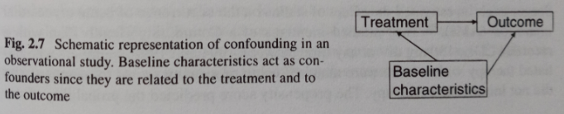
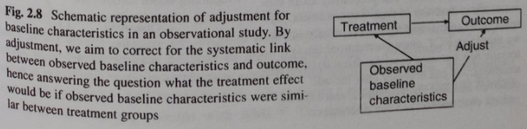
Common issues and statistical solutions (3)
Confounding: A lack of initial comparability in baseline factors or variables that leads to biased estimates of outcomes (Steyerberg). E.g., the treatment group was picked from younger patients while the control from older cases. Age is a confounder.
When treatments are compared, groups are often quite different because of a lack of randomization.
Subjects with specific characteristics are more likely to have higher or lower values of other predictors.
The figures below shows confounding and adjustment (add X to model).

Slide 59
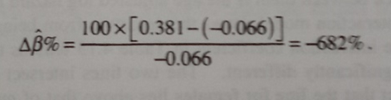
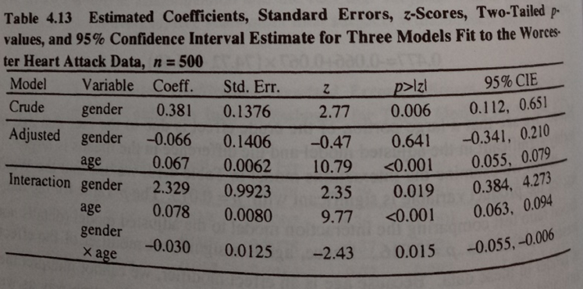
Common issues and statistical solutions (4)
Formula on confounding
Confounding: We can calculate confounding by comparing coefficients in 2 models: crude (1 predictor) and adjusted (2 predictors). If the effects and p-value changes at a substantial amount because of adding the 2nd variable, we have confounding.
For example, the crude model gender coefficient drops to -0.066 after adding age to the adjusted model.
The crude estimate is 682% larger than the adjusted estimate (see formula to the right) and greatly exceeds the 20% rule for important confounding.
We can also determine that age modifies the gender effect from the significant interaction coefficient of -0.030. We should use the Interaction Model’s results.

Slide 60
Common issues and statistical solutions (5)
Overfitting: Having too many predictors or too many degrees of freedom can cause overfitting. A model may not be as reliable in future samples.
Adjusted R2 (for overfitting), calibration, and discrimination statistics can provide more accurate results on model quality.
A rule of thumb is to not use more than 20 predictors in a model. For example, if we set an alpha level of significance to P < 0.05 and we have 20 significant predictors, then there is roughly as high as a 100% chance that we are wrong on at least 1 predictor being significant. Consider each predictor’s result as a hypothesis test and Type I error.
“Bonferroni Bounds” helps give accurate alpha levels on being wrong.

Slide 61
Variable selection
Selecting an adequate number of variables that prevents “overfitting” and “omitted variable bias”. To read more, see Harrell (Chapter 5) and Rosner (Chapter 11).

Slide 62
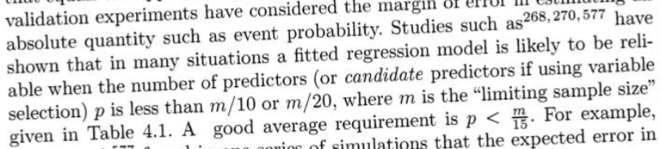
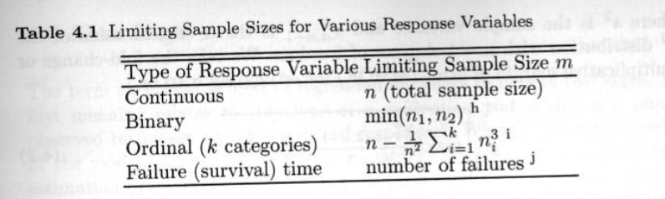
Rules on the number of predictors to use
For example, in the MTCARS data, if we divide n/10 and n/20, that suggests we can use 1 to 3 predictors in our model.
Max # of predictors should be about 20. From “Bonferrini bounds” and probability of 0.05*20 = 1.00 chance of being wrong in one of the predictors being significant.
Harrell prefers n/15 = 2 predictors
m = n
p. 72-73 of Harrell

Slide 63
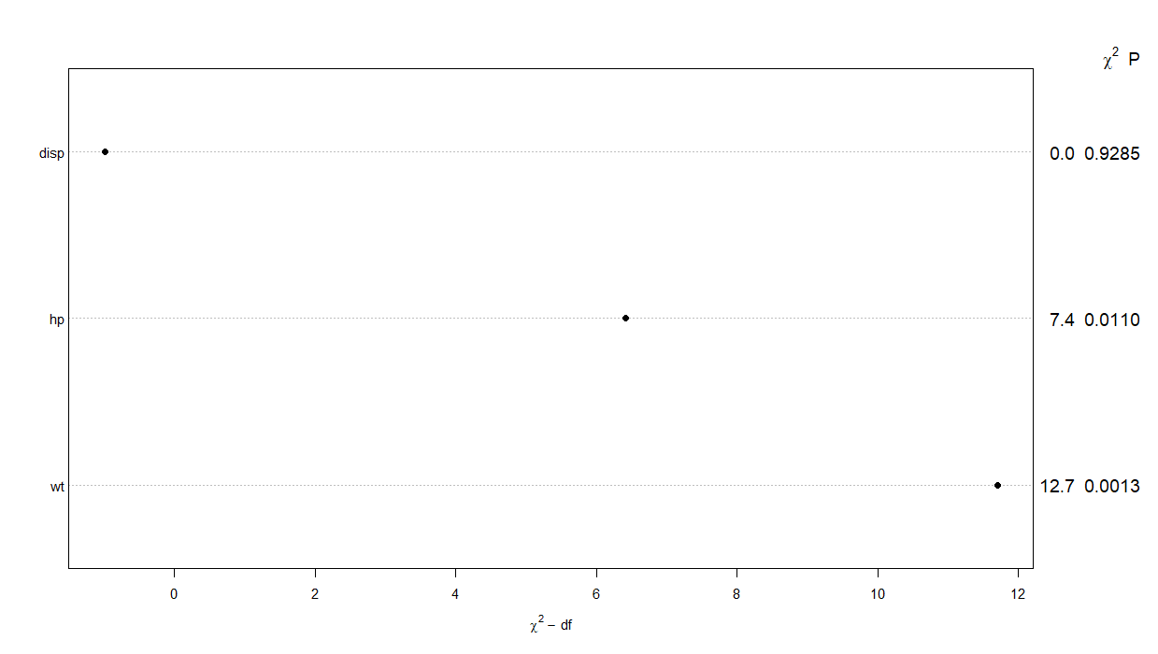
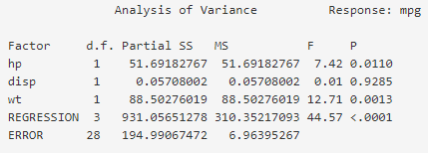
Keeping the most important predictors
A model with all clinically relevant predictors is better. But if a parsimonious model is desired that has the most power with the least number of predictors, determine the variable importance.
We can rank predictors by standardized regression coefficients. Not all predictors are on the same scale (e.g., car weight and horsepower) so this helps to show which predictors have the biggest impact on the outcome MPG. Rosner has an example on p. 471.
Harrell’s variable importance is a better option. It uses the F-statistic from the ANOVA table, the larger the value, the more important (see below). For a 3-level category (e.g., High, Medium, Low), the F-statistic is multiplied by 2 (# of levels - 1).
The Akaike Info Criterion (AIC), lower= better model.

Slide 64
Assessment of model fit
Examining model performance and effects of each predictor. To read more, see Moore & McCabe (Chapter 10), Pedhazur (Chapter 5), Rosner (Chapter 11), and Harrell book (Chapter 4).

Slide 65
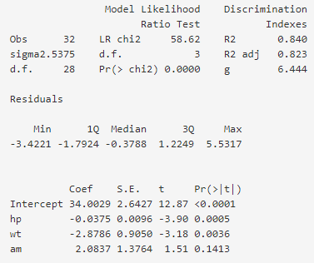
Model results. The R2 and coefficient results are more commonly reported results.
R2 tells us the proportion of variance in the outcome that is explained by the regression. This tells us how good the model works.
To the left we see “coefficients”. These are also called parameter estimates and regression weights. We can multiply a car’s variable values by the coefficient to calculate a predicted MPG.
Intercept standard in all models.
Adjusted R2 gives us a more conservative estimate to adjust for “overfitting”.

Slide 66
Interpreting model parameters. We are testing if the coefficient B = 0 (H0: B=0).
The model fits the data well, has a large effect (R2 > 0.26) and is very predictive (R2 > 0.70)
Intercept: The MPG of 34 is when all predictors = 0.
Intercept: This is always significant.
hp: For every 1-unit increase, there is a decrease in MPG by 0.0375, controlling for all other predictors (X).
hp: This is very significant, i.e., the confidence interval on coefficients does not contain 0 as a possibility.
wt: For every 1-unit increase, there is a decrease in MPG by 2.8786, controlling for other X.
When p < .05, it’s significant
wt: This is also significant. The trend is not flat, we feel confident that wt decreases MPG.
am: For a manual transmission, there is an increase in MPG by 2.0837, controlling for other X.
am: The trend is not significant, difference can be 0.

Slide 67
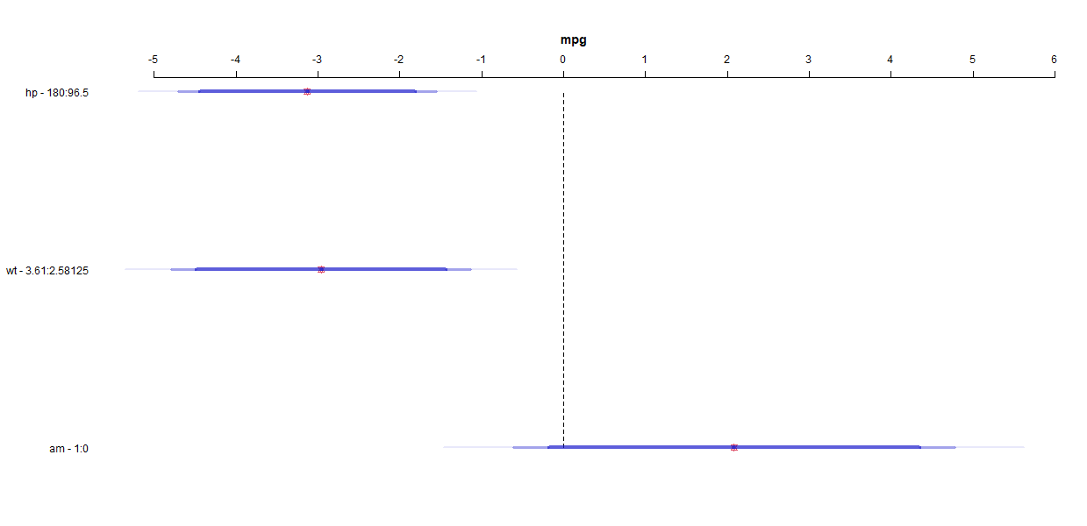
More on using confidence intervals to test regression coefficients of B= 0
Difference of 0
Horse Power
If a 95% confidence interval contains 0, then it is possible that “no effect” may be associated with the predictor.
90%, 95%, 99% confidence intervals
Weight
For example, horse power and weight are significant predictors of MPG. We clearly see 0 doesn’t lie within the blue bars.
Automatic or Manual Transmission
However, 0 is within the blue bar for transmission. It is possible that if we had many random samples that a difference of 0 would be found within many.

Slide 68
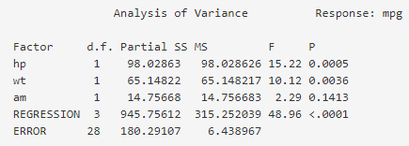
Model results
Below, we have an ANOVA table with F statistic results that indicate significance. The bottom 2 lines are the regression and Residual Error components. The ratio of 48.96 and a p-value <0.0001 indicates a significant regression and at least 1 significant predictor.
315.25 / 6.44 = 48.96

Slide 69
Missing data
Issues and solutions. To read more, see Harrell book (Chapter 3).

Slide 70
Types of missing data
MCAR (missing completely at random). Random in the strictest sense (e.g., data lost because test tube for labs broken).
MAR (missing at random). Data elements are not missing at random, but the probability that a value is missing depends on values of variables that were actually measured. For example, in a survey that asks about personal income, one group is less likely to answer. But the level of income is not correlated with the missingness. We can still impute income for them as long as we know they are in that group and because the incomes we do have for some are a random sample of all the group’s income.
IM (Informative missing). Elements are more likely to me missing if their true values of the variable in question are systematically higher or lower. An example is when subjects with lower income levels or very high incomes are less likely to provide their personal income in an interview.
MCAR and MAR are also called ignorable nonresponses while IM is called a nonignorable nonresponse.

Slide 71
How to deal with missing data
Proportion of missing <= 0.05. This isn’t a lot of missing data so simple options are available. For example, for continuous data, you can impute the median value for a predictor and for a categorical variable, you can impute the mode. You can also choose to ignore missing data and go ahead and use the variables as-is.
Proportion of missing 0.05 to 0.15. If the predictor has no multicolinearity, you can do the same as the above. If the predictor is correlated with other predictors, develop a customized model to predict your predictor of interest from all the other predictors. Then impute missing with predicted values. For related or unrelated predictors, variances need to be adjusted (single imputation but multiple imputation is better).
Proportion of missing > 0.15. Same considerations above but adjusting variances for imputation is even more important. Multiple imputation is preferred.
Multiple predictors frequently missing. The same considerations above but effects of imputations are more pronounced. The only way to know if these rules of thumb are adequate for a given dataset is to actually take missing values fully into account and to see if the results change.
If the main interest is prediction and not interpretation or inference about individual effects, it is worth trying a simple imputation (e.g., median) to see if the resulting model predicts the response almost as well as one developed after using customized imputation.
Perform the number of multiple imputations equal to the percentage of missing data. For example, 20% missing age data would require 20 imputations.

Slide 72
Interactions
When the effect of a variable is dependent on the levels of another variable. To read more, see Harrell book (Chapter 2).

Slide 73
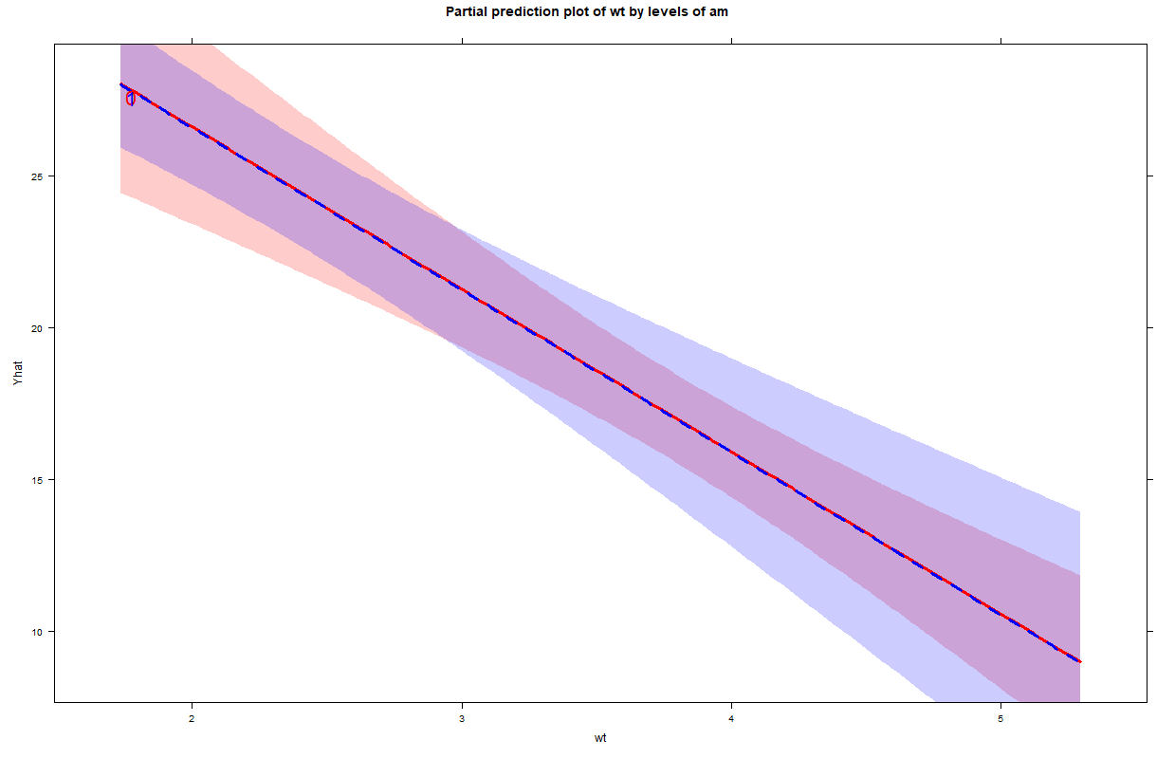
Relaxing the additivity assumption
A model with no interaction term predicts similar trends between weight and MPG for automatic and manual transmissions. They overlap.

Slide 74
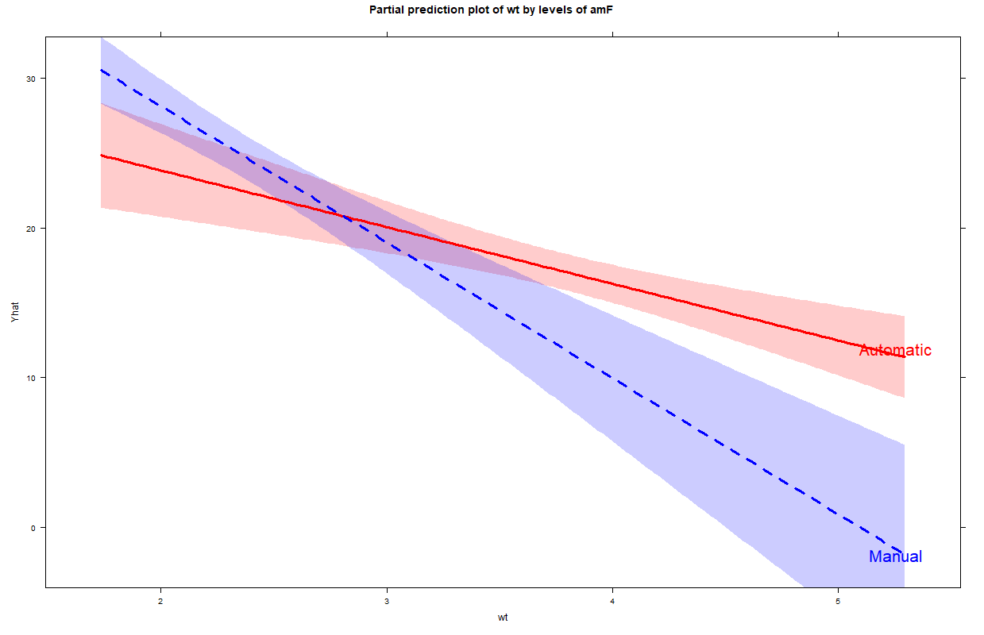
Interactions: The effect of car weight on MPG is dependent on the type of transmission
We relax the additivity assumption and allow for an interaction.
Lighter weight cars with manual transmissions begin with a higher MPG. But automatic transmissions generally have better MPGs over 3,500 pounds.
The interaction is significant (p<0.05) and significantly improves the model performance.

Slide 75
Nonlinearity
Nonlinear trajectories, finding a trend that matches your data, potential transformations. To read more, see Harrell book (Chapter 2).

Slide 76
Introduction
Relationships among variables are seldom linear (Harrell, 2015).
When we have a nonlinear relationship, we have 3 options: 1) use the predictor “as is” in the model, 2) use a nonlinear term in addition to the main effect (Y ~ X + X^2) in the regression model or 3) replacing the predictor with transformed values in the model.
All options can have benefits in different situations. Polynomials (X^2, X^3) are good options in a variety of nonlinear patterns. (See Singer & Willett book to learn more).
But making changes can improve model performance and give more accurate results.
Polynomials can show that some effects “increase at a decreasing rate”. E.g., the coefficients X > 0 and X^2 < 0 indicate the curve initially starts off going upward but eventually goes down. We can calculate that point of inflection, where the effect wears off. See appendix to learn more.

Slide 77
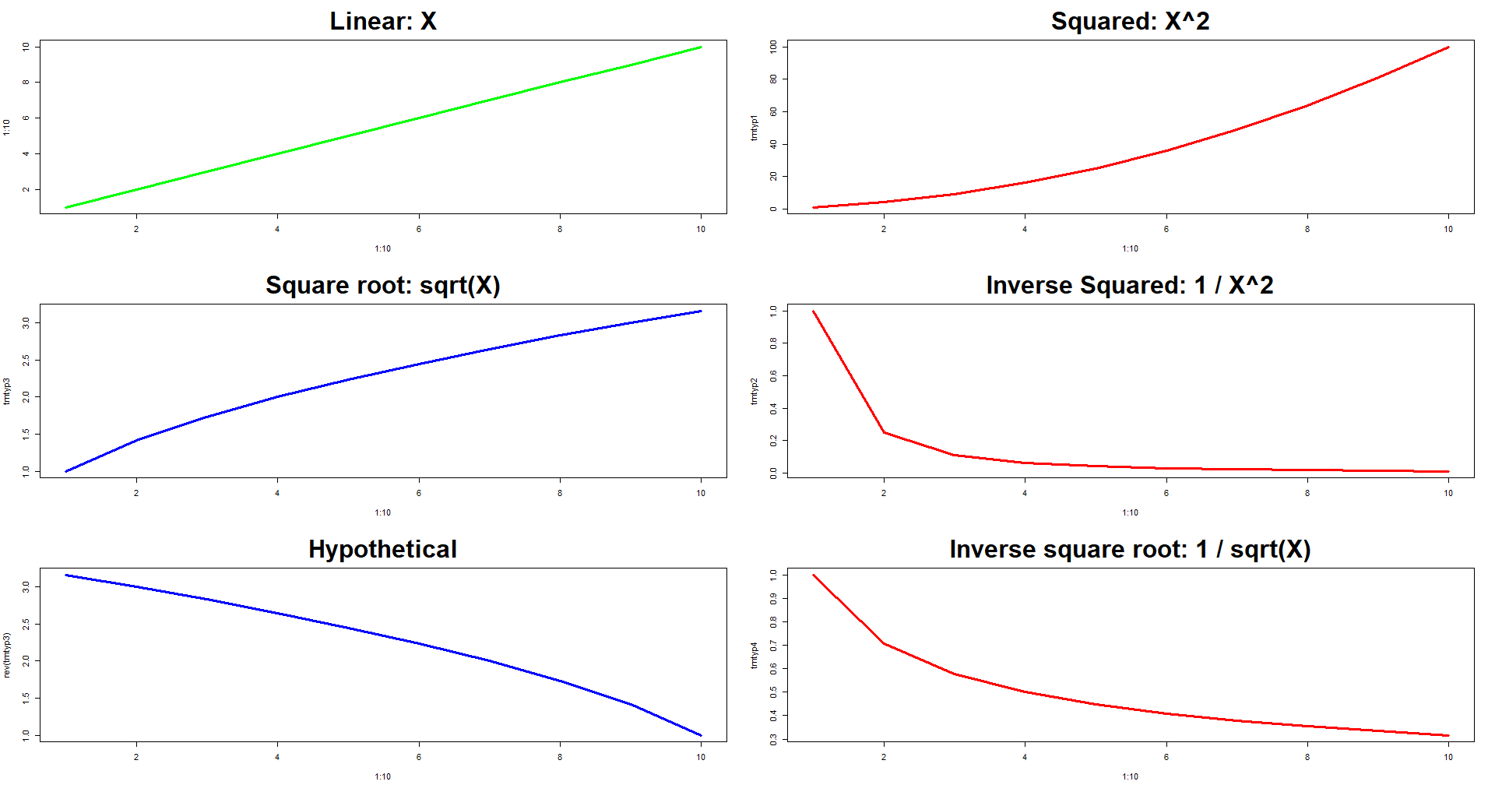
Interpreting non-linear trends
Increasing at a constant rate
Increasing at an increasing rate
Main effect > 0
X^2 > 0
Main effect > 0
Modified X = 0
Increasing at a decreasing rate
Decreasing at an increasing rate
Main effect < 0
1/X^2 > 0
Main effect > 0
sqrt(X) < 0
Main effect < 0
Hypothetical X < 0
Decreasing at an increasing rate
Main effect < 0
1/sqrt(X) > 0
Decreasing at a decreasing rate

Slide 78
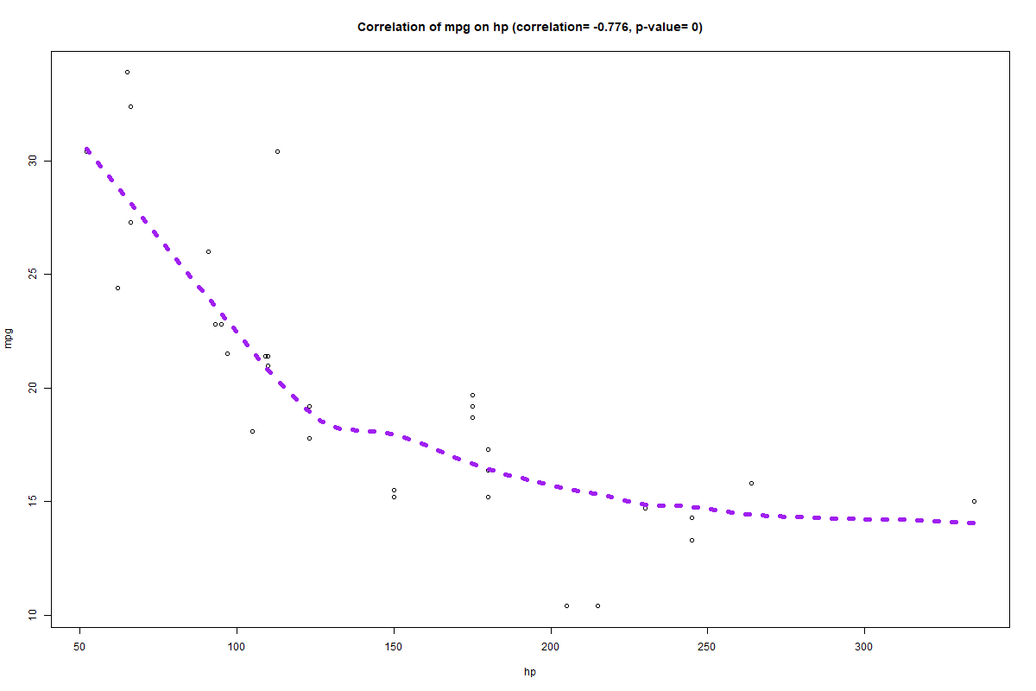
The relationship shows a steep downward trend that lessens to a milder level at 125 horsepower
In other words, the trend is nonlinear and decreasing at an increasing rate.
For right skewed predictors (outliers exist in the highest values), natural log or log10 transformations may improve model fit by giving a linear relationship with the outcome.
Other transformation options include square roots, inverse squared (1/x^2, and the other options listed earlier.
Horsepower

Slide 79
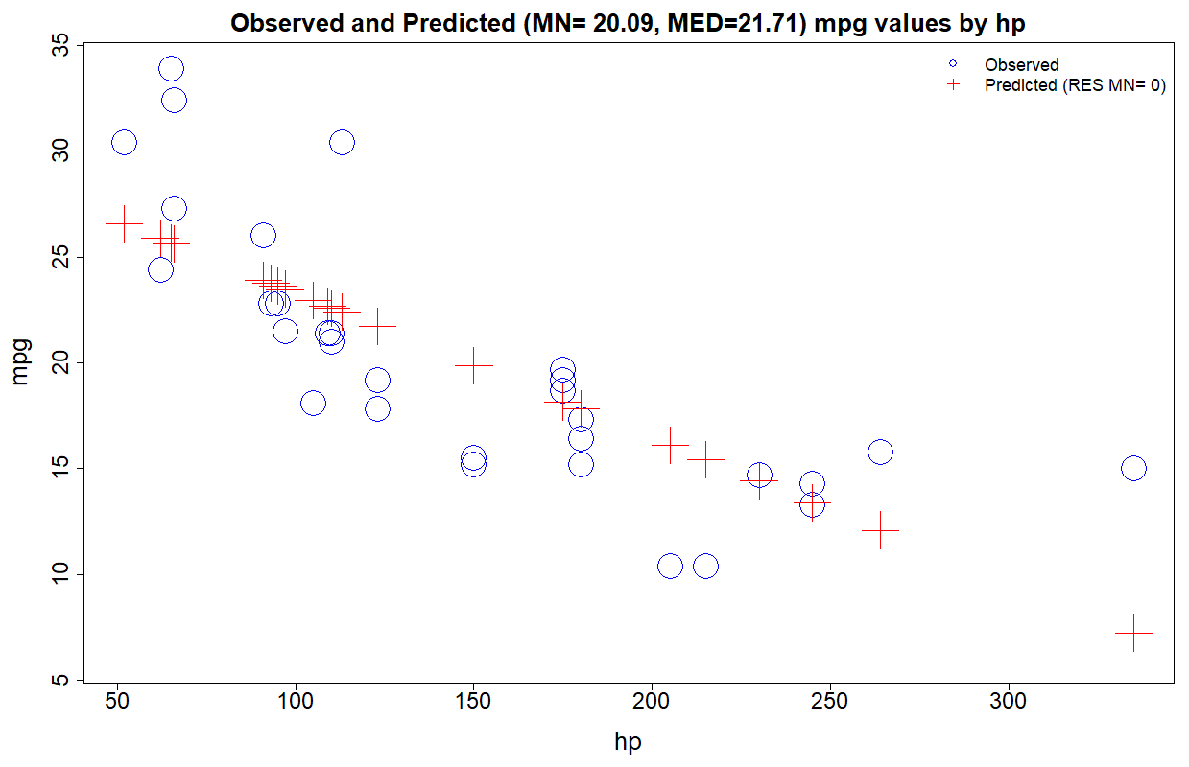
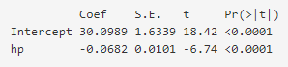
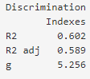

Linear model: mpg ~ hp
Linear relationship between mpg and hp
Residuals= 3.7 and 7.8. Be aware of the influence of outliers in your model.
Horsepower

Slide 80




Decreasing at an
increasing rate
Quadratic model: mpg ~ hp + hp^2
Improved model performance from adding in a nonlinear term to the model.
Predictions are now closer to the actual observed scores in the previous slide.
The red + of predicted values now represents a curvilinear trend in the data.
Horsepower

Slide 81

Nonlinear relationship between mpg and 1/4 mile time (qsec). This trend is better described as a “cubic” model. The mpg rate begins to decrease around 17 but then increases at 18.
This may be even be a “quartic” model because the trend decreases after 20 but only for 1 data point so a cubic model may be more representative of the data.
We have 2 “peaks and at least 1 “trough”.
Quarter mile time (seconds)

Slide 82

The cubic model gives predictions closer to the observed score but it is important to consider overfitting and interpretability of the model for your audience. A quadratic or linear model have less overfitting/higher adjusted R2
Polynomial R^2
Linear (qsec): 0.175
Quadratic (qsec + qsec^2): 0.180
Cubic (qsec +qsec^2 + qsec ^3): 0.205
Quarter mile time (seconds)

Slide 83

Splines (1) Nonlinear trend lines.
Taken from the concept of a “draftsman spline”. See “Harrell RMS reader Splines.pdf” to learn more.
Not many things have a true linear relationship between the predictor and outcome. Splines are a valuable method for dealing with nonlinearity.
These are piecewise polynomials, similar to using a squared value or quadratic polynomial (e.g., age + age^2). They can go beyond squared or cubed segments.
We allow the trend to bend at values 1, 3, and 5.

Slide 84

Splines (2) Nonlinear trend lines.
Splines, especially “restricted cubic splines” have advantages over other approaches and provide more accurate results and better model performance.
For example, they can take any shape. Otherwise we would need to specify the shape by creating age + age^2 + age^3.

Slide 85
Summary
If a predictor is transformed, you only need to include that transformed value as the main effect (e.g., mpg ~ hp^2).
If making the predictor a nonlinear fit, you need to add both the main effect in its original predictor values and the transformed values (e.g., mpg ~ hp + hp^2).
Consider your audience, if you are interpreting effects for your audience, using nonlinear terms will be more helpful than complex transformations (e.g., 1/sqrt(X) ). But if you get an effective transformation and only interested in predicted values, transformed variables will be easier to use than 3 degrees of freedom cubic models.

Slide 86
Weighted Least Squares Regression
Frequency, Population, Importance and heteroscedasticity.

Slide 87

Weighted Least Squares Regression (same as OLS but adds a weight variable)
Weights are used to increase or decrease the impact of specific rows of data in a regression. They can help if the homoscedasticity assumption is violated. A larger weight value = more influence.
When homoscedasticity assumption is violated. Calculated so the observations with lower variance are given more weight: 1/ (residuals – predicted values^2).
Weights should be integers and non-negative values but just having non-negative values should be enough. Weights are added along with other regression settings, stats software will take it from there.
And weights can be based on: Frequency (e.g., 1 row of data equals 100 rows in a larger dataset), Probability (e.g., underrepresented groups in survey samples), Analytic (aggregated data with means and weights equal to N in the calculation), Population (e.g., # of patients at a location), and Importance (e.g., what we consider more important based on theory, recent time points may be less important).

Slide 88
Examples of weights. Weights are calculated and added into data as an extra column
Type of weight
Weight formula and example value
Frequency: 1 row represents 100 rows of a bigger dataset
Probability: We surveyed 2 of 5 patients and weight on sample.
Analytic: From aggregated means, the N from the formula.
Population: Sample size (either patients or patient days.
Importance: We consider some data more/less important or accurate. We weight according to our preference.
For homoscedasticity: Difference in residuals and predicted values.
Frequency = Weight. 100 rows = 100.
Inverse proportion = Weight. 5/2 = 2.5.
N = Weight. LOS average of 3 (15 days /5 patients) = 5.
N = Weight. 100 patients or days = 100.
Preference= Weight. The last 3 months of multiyear data is less reliable. 0.5=last 3, 1=other months.
1/ (residuals – predicted values^2). 1/(6 - 2^2) = 0.50.

Slide 89


Unweighted regression: MPG = hp.
Linear model: mpg ~ hp
Linear relationship between mpg and hp
Residuals= 3.7 and 7.8. Be aware of the influence of outliers in your model.
Horsepower

Slide 90




Weighted regression: MPG = hp.
Model performance improves.
Residuals= 5.7 and 10.8. Residuals are 2 and 3 mpg higher because they carry less weight. The predicted regression line is pulled less towards these values.
Both coefficients and our interpretation changes from using weights.
Horsepower

Slide 91
Summary
Weights can help give more accurate results from making things more balanced.
Weights should be numbers greater than 0 (i.e., not negative values).
If doing a time-series analysis and we want the most recent time point to be weighted less because we are less certain about its effect and concerned that month will have too much “influence”, we can assign a lower weight.

Slide 92
Aggregated data
Uses and methodological concerns

Slide 93
Issues
Aggregated data can be helpful when there is at least 25-30 rows of data. Consider a regression for 2 to 3 years of monthly data. However, it is important to caution this use because aggregated data can mask variance and inflate correlation coefficients (i.e., correlations could look better than they are).
The problem with aggregated data regression. “The other alternative is to aggregate the individual-level variables to the higher level and do the analysis on the higher level. Thus, we aggregate student characteristics over classes and do a class analysis, perhaps weighted with class size. The main problem here is that we throw away all the within-group information, which may be as much as 80% or 90% of the total variation before we start the analysis. As a consequence, relations between aggregated variables are often much stronger, and they can be very different from the relations between the nonaggregate variables. Thus, we waste information, and we distort interpretation if we try to interpret the aggregate analysis on the individual level. Thus, aggregating and disaggregating are both unsatisfactory.” (Raudenbush & Bryk).
When we use aggregated outcomes, we can only use aggregated predictors (e.g., average age per medical center). Because the model is at the aggregated level, we should be very careful on making inferences at the individual level and should not make predictions on individual units such as patients at hospitals.
When doing a regression with aggregated data, consider using a weight. Most statistical software will then perform a weighted least squares regression. (See the review above).

Slide 94
Data reduction
Hierarchical Cluster Analysis of predictors. To read more, see Harrell book (Chapter 4).

Slide 95
Background
Collapsing many highly related variables into 1 variable can make the model more reliable and provide more accurate coefficients.
Coefficients from collinear variables can be inflated so high that interpreting gives impossible conclusions.
Reduce degrees of freedom. The higher the number of parts in a regression, the harder it will be to replicate in future data. This would make our results less reliable and less accurate.

Slide 96

Hierarchical Cluster Analysis of predictors
Car weight and automatic or manual transmission status are correlated. Manual transmissions cars are generally lighter.
The lower these variables converge in the dendogram, the higher the correlation between the variables. These 3 variables tell us about engine size or power.

Slide 97


Principal Components Analysis
PCA can identify the potential number of factors we have. We generally use a cutoff of > 1 Eigenvalue (y-axis) to determine how many factors to create because they would explain an above average amount of variance in the factor. For values below 1, we might as well use each variable separately.
For example, above, we see only 1 factor has a value on the Y-axis above 1. Based on the cluster analysis, we feel we should create a factor that contains “hp”, “cyl”, and “disp”.

Slide 98


Comparing models when using a factor (horsepower, cylinders, engine displacement)
No factor
Engine size factor
R2= 0.854, Validated R2= 0.775.
R2= 0.826, Validated R2= 0.792.
Less overfitting with the factor.
The bigger or more powerful the engine, the lower the miles-per-gallon.

Slide 99
Model validation
Assessing how well our regression model will predict in future data. To read more, see Harrell book (Chapter 5).

Slide 100
Validity
Validity: Approximate truth of an inference. When we say something is valid, we make a judgment about the extent to which relevant evidence supports that inference as being true or correct. Usually that evidence comes from both empirical findings and the consistency of these findings with other sources of knowledge, including past findings and theory. (Shadish, Cook, & Campbell)
Issues concerning the trustworthiness of conclusions based on studies can be classified in a few ways that concern the validity of conclusions for the specific subjects observed in the setting and circumstances where research data were collected (internal validity) and those that concern the generalization of those conclusions to other subjects (e.g., patient types), other settings (e.g., other med centers) or other circumstances (external validity).
Types of validity:
1. Internal validity ("did in fact the experimental stimulus make some significant difference in this specific instance?"). Refers to inferences about whether observed covariation between A and B reflects a causal relationship from A to B in the form in which the variables were manipulated or measured. To support such an inference, the researcher must show that A preceded B in time, that A covaries with B and that no other explanations for the relationship are plausible.
2. External validity ("to what populations, settings, and variables can this effect be generalized?")
3. Statistical conclusion validity: Refers to the appropriate use of statistics to infer whether the presumed independent and dependent variables covary. Statistical conclusion validity concerns 2 related statistical inferences that affect the covariation component of causal inferences: 1) whether the presumed cause and effect covary and 2) how strongly they covary. For #1, we can incorrectly conclude that cause and effect covary when they do not (Type I error) or we can incorrectly conclude that cause and effect do not covary when they do (Type II error). For #2, we can over or underestimate the covariation. By not testing the predictor and outcome at all, we have no statistical conclusion validity to speak of.
Shadish, Cook, & Campbell

Slide 101
Model Validation: Calibration and Discrimination
Calibration: Models are calibrated to a dataset when the average of their predicted values matches the average of the actual outcomes. Models should be re-calibrated if the calibration weakens over time, especially if the model was developed outside of your organization (Morton, pp. 128-129).
Overall calibration error: Average of Y – Average of predictions. If using ordinary least squares, the calibration error = 0 in the original data.
A calibration curve can help visualize the calibration. We can select deciles or quintiles of the sample and plot the average outcome and predicted values in each group.
Discrimination: The extent to which a model predicts higher outcomes for those with higher outcomes. This is R2. We can also use MAD. This is an individual level summary.
“While good model calibration is desirable, discrimination is usually more important” (Iezzoni, p. 253).
For example, if the average length of stay is 3 days, a model that assigns predictions of 3 days to everyone is perfectly calibrated. But a model that assigns 3-day predictions to those who actually stay 3 days while just assigning 1-day predictions to those who stay only 1 day, that model provides more useful information.

Slide 102
Discrimination
Discrimination is the model’s ability to separate subjects’ outcomes.
The worth of a model can be judged by how far it goes out on a limb while still maintaining good calibration.
If one model assigns 2% of the sample to a risk of dying above a predicted value of 0.90 while the other model assigns 8% of the sample to the same high-risk group, the second model is more discriminating.
Discrimination is assessed with R2. A primary interest is comparing the R2 in the training and test sets, a large drop in R2 in the test set indicates overfitting.

Slide 103
Comparing two models
Frequently one wants to choose between two competing models on the basis of a common set of observations.
In this case, the predicted values calculated from the training set results can usually be considered a new variable for comparison with responses in the new dataset.
These methods listed below will also work if the models are compared using the same set of data used to fit each one, as long as both models have the same variables and terms (e.g., same nonlinear variables and interactions).
This prevents us from rewarding a model just because it overfits the training sample
The methods can also be enhanced using bootstrapping or cross-validation on a single sample to get a fair comparison.
Some of the criteria for choosing a model are (Harrell, 2015):
Calibration.
Discrimination.
Face validity.
Measurement errors in required predictors.
Use of continuous predictors (which are usually defined better than categorical ones).
Incorrect omission of “insignificant” variables that would make sense as risk factors.
Simplicity (less important with computing power).
Lack of fit for specific types of subjects.

Slide 104
How to validate a model for predictions. Split-half method.
Randomly draw ½ of the rows of data. This is your training set.
Set aside the other ½ of the rows of data. This is your testing set.
Develop your model on your training set. Gather your coefficients.
Calculate the predicted outcomes for each row in your testing set. For example, {38.75 + [–0.94*cyl] + [–0.018*hp] + [–3.17*wt] }.
Calculate calibration and discrimination (e.g., R2) results. Discrimination is generally considered more important.
Compare the training and testing sets. If both models have similar results and both meet your criteria, then you have a validated model. If dissimilar results, report the lower of the calibration and discrimination results.

Slide 105


Comparing 2 models: Original and a model with a factor. Example of overfitting
Validated performance
mpg = (wt * am) + cyl + disp + hp
More overfitting
Interaction
Interaction
mpg = (wt * am) + factor
Less overfitting

Slide 106
Additional topics
Generalized Least Squares regression, Hierarchical Linear Modeling, Sensitivity Analysis, and Decision Analysis for using prediction cutoffs

Slide 107
Generalized Least Squares regression
We look at responses of measurements over time within subjects and between groups. This setup induces correlations between measurements on the same subject (autocorrelations) that must be taken into account to have optimal model fits and honest inference. If not, we will violate the assumption of independence.
This requires a group variable like a medical center name or person ID if these are repeated outcomes on the same patient.
This was an early extension of ordinary least squares (multiple linear regression). It only requires an extra variable for the grouping (clustering).
For health care studies, this would help when comparing hospitals or patients. However, it can have issues when there are many groups or in very large datasets.
To read more, see Harrell RMS Reader (Chapter 7).

Slide 108
Hierarchical Linear modeling
This method also is helpful when there is clustering in the data.
This can be repeated outcomes measurements for each patient or many observations within medical centers.
This extension of multiple linear regression is designed for when the variation in groups is of key interest (e.g., hospital standardization).
Most times, a regular multiple linear regression will suffice. However, if we want to study the variation between persons or groups like medical centers, HLM provides useful measures of between-group variation.
See tables 4 and 5 in Zuniga & Howes (2009) to see the additional within- and between-person variation results.

Slide 109
Sensitivity Analysis (See Saltelli, 2008)
Sensitivity analysis is how the variation in the outcome Y can be portioned out to different sources of variation in the predictors.
It often happens that the model turns out to be highly tuned to a specific value of a factor.
The simulated (bootstrapped) sample is fed through the model formula, i.e., the model is run repeatedly for each simulated value to obtain an output sample for the variables of interest. This can be used to build an empirical probability distribution for the response variable. Means, SD, 95% CI, etc. can be estimated.
How to perform a sensitivity analysis: A) Design the model, select predictors to consider; B) assign probability density functions to the predictors; C) generate a predictor/vector matrix—i.e., run the model to get parameters; D) evaluate the model—e.g., get predicted values from the simulated data; assess the importance of each input on the output variation.
For example, we use our coefficients to ask the what if questions: “What if we saw a 20% increase in infections, what would that do to our average length of stay?”. Or “what if our average inpatient age increased by 10 years, what would our average costs look like?”.
We can also figure out what things give us the biggest bang for our buck. If we find out the outcome is most effected by 1 or 2 variables, then we improve the outcome with the least resources.

Slide 110
Decision Curve Analysis: Considerations in predicting outcomes
Potential benefits: Predictive models and assessment scales can identify those likely or unlikely to have an extended length of stay, fall, 30-day readmission, etc.
Cost of interventions (time, money, quality of life, etc.): When deciding on using predictions or scales, we must consider how costly interventions are (e.g., 10% cutoff: “preventing 1 readmission is worth the cost of intervening on 9 patients who wouldn’t be readmitted”).
See Vickers, 2019.
Notes:
About 2/3s of falls happen are inpatient and about 1/3 in the ED.
There were about 107,000 and 121,000 admits or discharge (including observations) in SCAL for 2020 and 2021. KP Insight HUS report.
As an extreme example, suppose an event happens once a year in SCAL, any preventative efforts will reduce the event by a count of 1 using an excellent prediction model or assessment scale.
Hester-Davis was developed in the ER setting not the inpatient. Many fall studies show tools not working as well in different settings.

Slide 111
What is a Decision Curve Analysis?
A decision analysis allows us to determine the optimal cutoff in which we intervene based on our predictive model or assessment scale.
For outcomes with high risk to life, we may set a lower cutoff. We may also set low cutoffs if the intervention costs are very minimal (i.e., we compare cost and benefit).
For rare events with expensive interventions, there can be more opportunity for savings by identifying those with low risks (e.g., falls) so we can avoid unnecessary interventions.
DAs can guide us in how we balance the costs for preventing an outcome compared to the cost of interventions for those who never would have the outcome (e.g., 1 readmission = 9 non-readmits) .
Notes:
For example, the DKA model was for missed outpatient appointments which had a rate of about 10%. The intervention was an extra automated call for those likely to miss an appointment which cost us nothing.
If a fall costs $25,000 like HD stated, with a 1% fall rate, then things balance out if the average non-fall intervention costs do not exceed $250 per patient

Slide 112
Case study 1: Hypothesis testing, effect size measurement, and predictive modeling
Predictive and Explanatory models: Forced Expiratory Volume and Very Low Birthweight studies.

Slide 113
Predictive modeling
Relaxing the assumptions of linearity and additivity, validation of calibration and discrimination, nomogram, Decisions Curve Analysis based on a selected cutoff level

Slide 114
Pediatric forced expiratory volume study (FEV). Breathing test (N = 654).
fev: Maximum forced expiratory volume in one second age: Age in years height: Height in inches sex: 'male' or 'female' smoker: 'current smoker' or 'non-current smoker’
We will first examine descriptive statistics of the average FEV outcome by categories and by quartiles of continuous variables.
This is a powerful tool to spot trends in the data and for model development.
For example, large jumps in rates for quartiles can signal nonlinearity.

Slide 115

Means of the outcome by quartiles or categories.
Quartiles
Large jump in rate can signal nonlinearity
An increasing pattern suggests linear trends for continuous predictors
A large group difference between smokers and non-smokers

Slide 116

Linear and additive model summary
Model: fev = age + sex + height + smoke
Prediction formula for data:
-4.4569739 (Intercept) + [0.065509323 * age] + [0.1571029 * (sex == "male")] + [0.10419943 * height] +[–0.087246393 * (smoke == "current smoker")]
Age Reg. Coefficient
Unique patient Age value

Slide 117
Model performance from using different methods
All models perform well (R2 > 0.70). The 1st model may best combine power and simplicity of use. Only performing slightly less than the best.
“Akaike Information Criterion”—Lower is better
Relaxing the linearity assumption by using a nonlinear term (predictor), increased model performance the most
 | Predictors
Model | age | height | sex | smoke | R^2 | Validated R^2 | AIC
Linear and additive | - | - | - | - | 0.775 | 0.771 | 703.8
Interaction | X | - | X | - | 0.784 | 0.779 | 678.9
Nonlinear | X | X | - | - | 0.798 | 0.789 | 646.7
Nonlinear and interaction | X | X | X | - | 0.807 | 0.796 | 625.7

Slide 118

Shows effects when going from the 25th to the 75th percentiles, 0-to-1 binary values, or the most common category to other categories.
Model summary
Nonlinear and Interaction
Coefficients come in increments of 1 but sometimes it’s more informative to go from the 25th to the 75th percentiles (e.g., height).
Effects above 0 indicate a positive increase in the outcome.
Effects below 0 indicate a decrease in the outcome. Effects are significant when the blue confidence interval bar excludes 0. The bars are 90/95/99 confidence intervals.
Not significant in the additive/linear model but significant here

Slide 119


The most important predictors of Y have dots furthest to the right and bigger F statstics.
Variable Importance with p-values, larger “X2” is better

Slide 120

Shows trend lines while holding other X constant at their “average” value.
Partial prediction plots
Age shows a moderate effect but explodes after 10.
Height has the steepest trend and is the most predictive.
“The effect size while holding other predictors constant” or “controlling for other predictors” means we use the average for each predictor to calculate other predictor effects. For example, the predicted FEV for age = 5 and 10 uses the same other predictor values in the formula:
-4.5 + 0.07*age=5 + 0.16*male + 0.1*height 62 + -0.1*non-smoker
-4.5 + 0.07*age=10 + 0.16*male + 0.1*height 62 + -0.1*non-smoker

Slide 121

The significant interaction shows the gender effect on FEV is dependent on the patient’s age. As expected in research, differences are strongest after puberty starts.

Slide 122

Combining research and regression. This linear interaction model shows a difference between boys and girls. But wrongly suggests a significant difference starting before the age of 10.
Reinforcing the model results with the established research finding that differences begin around puberty, at age 12 and not at 9, can help (e.g., interventions start at the right age).

Slide 123
Model summary: Interpreting results (fev = Nonlinear age * sex + Nonlinear height + smoke)
The smoking effect is significant at the 0.05 level (p = 0.03). There is an expected lower FEV by 0.12 for patients who smoke, after controlling for age, height, and sex.
There is a significant age by sex effect (p < 0.001) after controlling for other variables. Boys have significantly higher FEV levels beginning around the age of 12 (p < 0.01). There is also a significant positive nonlinear trend for age (p < 0.001).
There is a significant positive height effect (p < 0.001) after controlling for other variables. There is also a significant nonlinear trend for height (p < 0.05). Height is the most important predictor as it has the most predictive power. For example, going from the 1st to 3rd quartiles (about 11 inches) increases the FEV by 0.9.
The model has a high level of reliability, R2= 0.81 (validated= 0.80).

Slide 124


Calibration curve
Traditional
Bootstrapped bias-corrected
Both graphs show a very high degree of calibration among all levels of predicted values.

Slide 125

Validation (Calibration and Discrimination)
Alternative: Report index corrected results for Bootstrapped bias-corrected method
Full data model
Training and test data models
Discrimination
Calibration
Reporting validation for the split-half method: 1) Describe the original full data model results, 2) compare the “training” and “test” data results, 3) if dissimilar (above is similar), list “optimism” and the index corrected results, or 4) try another random draw.
Optimism= training – test
Index.correceted = index.original - optimism

Slide 126

Model selection
Model performance
Purpose: Ease of interpretability vs. predictive power
Nomogram: Making predictions easier to understand.
Linear/additive model and nonlinear/interaction model

Slide 127
Nomogram
A nomogram can be used to calculate individual predicted FEV levels for patients.
It can also be used to demonstrate how the model works for clinical staff.
A nomogram works by identifying the “Points” for each predictor of a specific patient. Then sum up the points to get the “Total Points” and find the corresponding predicted score in “Linear Predictor”.
For example, a 12 year-old boy (19 points) who is 55 inches tall (20 points) and a non-smoker (4.5) has (43.5 points) a predicted FEV = 2.25.

Slide 128

1. Gather points for each X
The model can be used to predict individual FEV values or reference ranges for hospitals.
A wide spread in the point bar indicates an important variable because every value counts.
2. Sum the total points
3. Find the corresponding prediction

Slide 129
What’s next? Select a cutoff level.
Pediatric FEV is heavily dependent on age. Most values are interpreted based on age or considered normal if their value is at least 80% of the predicted level.
Consider the scenario that you are asked to test a cutoff of 3 based on your predictive model. Four liters of air is considered healthy for adults, a child’s FEV level of 3 might be considered healthy.
Children are given predicted scores based on their 4 predictor values.
Determine the AUC (or C statistic) when using your cutoff level and provide consultation on adjusting the cutoff.

Slide 130


Sensitivity
(true-positives)
The model is best at identifying which children aren’t grown enough to have equivalently healthy adult lungs yet. Consider using it for that purpose too (reduce tests, save $$)
Specificity
(true-negatives)

Slide 131
Decision Curve Analysis
Evaluate the prediction model to determine its “Net Benefit” or determine the number of interventions avoided based on your cutoff level.

Slide 132


A net benefit of 0.0973 indicates that the difference between our true-positives and false-positives will be finding about 10 more true positives per 100 patients using a cutoff of FEV= 3.
The X-axis corresponds to the percentiles of the distribution of predicted scores (e.g., the 75th percentile is 3, this lines up with the Y-axis value Net Benefit= .0973).

Slide 133

These are interventions avoided. We can avoid about 58 of 100 unnecessary interventions with a cutoff of 3.
The reason is the model has a high specificity level and the majority of patients won’t have an FEV over 3. The volume of higher patients on the lower end gives more opportunity to avoid interventions.

Slide 134
Explanatory model
Hypothesis testing on very low birthweight, risk adjustment, and sensitivity analysis

Slide 135
Very low birth weight study (N = 189)
bwt= birthweight in grams
age
smoke= Smoker or not
ftv= Number of visits to the physician
lwt= Weight at last menstrual period
parity= Number of previous births
ptl= Premature labor history
ht= History of hypertension
ui= presence of uterine irritability

Slide 136

Means of the outcome by quartiles or categories.

Slide 137

Summary (bwt = age + Smoker + lwt + ftv + parity + ptl + ht + ui)
For every pound increase in mother’s weight, there is an expected increase of 4.01 grams.
Key predictors in research, smoking, hypertension and UI significantly reduce birthweight by 234, 587, and 559 grams after controlling for other variables.
Smoking rate is a health outcome worth improving.
For categorical X, a reference group is compared with each level (PTL=0 vs 1, 0 vs 2, 0 vs 3) and these are the results we see in the output.

Slide 138

Shows effects when going from the 25th to the 75th percentiles, 0-to-1 binary values, or the most common category to other categories.
Model summary
This confidence interval is very wide because only 1 case = 3. Consider recoding or investigating influence.
Effects above 0 indicate an increase in the outcome.
Effects below 0 indicate a decrease in the outcome. Effects are significant when the blue confidence interval bar excludes 0. The bars are 90/95/99 confidence intervals.

Slide 139

The most important predictors of Y have dots furthest to the right.
Variable Importance

Slide 140

Shows trend lines while holding other X constant at their “average” value.
Partial prediction plots

Slide 141
Model selection
The more complex models don’t validate well, choose the simplest model for reliability and interpretability to your audience. Ask if we should use smoke*age.
Recommended
 | Predictors
Model | age | Smoker | lwt | ftv | parity | ptl | ht | ui | R^2 | Validated R^2 | AIC
Linear and additive | - | - | - | - | - | - | - | - | 0.226 | 0.102 | 2971.2
Interaction (and linear) | X | X | - | - | - | - | - | - | 0.272 | 0.15 | 2961.9
Nonlinear (and additive) | X | - | - | - | - | - | - | - | 0.26 | 0.092 | 2968.9
Nonlinear and interaction | X | X | - | - | - | - | - | - | 0.301 | 0.099 | 2966.1
Lower AIC = Better

Slide 142
Sensitivity analysis
Once we have the regression coefficients from our model, we can calculate how the birthweight rate can change if we modify the distribution of our predictors.
For example, what would happen if we cut the proportion of smokers in half?
We can identify the predictors that give us the biggest bang for the buck in performance improvement.
We can also eliminate factors that are unlikely to help improve outcomes, therefore saving resources.

Slide 143

The “tornado plot” shows the predictors that the outcome is most sensitive to at the top as standardized coefficients (i.e., modifying these variables will move your outcome rates the most).
Although not the most important, the mid-range Smoker variable may have a clinically relevant objective of reducing rates.

Slide 144


Sensitivity analysis. For low birthweights (<2,500 grams), what if we reduced smoking from 40% to 20%?
Clinical staff may or may not consider the reduction in low birthweights worth the resources to pursue, either way a SA informs that decision.
40% of mothers smoked
20% of mothers smoked
12% of babies born at a low birthweight
9% of babies born at a low birthweight

Slide 145
Case study 2: Health economics, cost, and time
Diagnostic and prognostic models: Predicting cost and length of stay during hospital stays

Slide 146
Comparison of diagnostic and prognostic models
Diagnostic
Prognostic
Explanatory/retrospective.
Looks back at existing data, both predictor and outcome values are already known. Provides hypothesis tests and effect sizes.
Generally uses more predictors. Results have a higher R2.
In a study on cost, will include LOS and death because all patients were discharged.
Predictive/prospective.
Applicable to future data but is developed on existing data. Uses variables with values available at study entry to make predictions.
Uses fewer predictors to make same day predictions. Lower R2.
In a study on cost, will not include LOS and death because that is unknown at admission.

Slide 147
Study to Understand Prognoses and Preferences for Outcomes and Risks of Treatments (SUPPORT by Professor Frank Harrell, Vanderbilt)
Study to examine the outcomes of seriously ill hospitalized patients.
Data collected from 1991-1994. N= 9,105
Two of the outcomes are cost and length of stay.
Most variables are lab values from the patient’s stay with some demographic information.
Some variables have missing data as high as 50%.
How to build a reliable model with high missing data and highly skewed outcomes?
Alternatives include the Cox Proportional Hazards model.

Slide 148


Positive skewed (right tailed) cost and LOS outcomes
Cost
LOS

Slide 149
age | Age | ca | Cancer
death | Death at any time up to NDI date:31DEC94 | prg2m | MD 2 Month Survival Estimate
sex |  | prg6m | MD 6 Month Survival Estimate
hospdead | Death in Hospital | dnr | DNR order
slos | Days from Study Entry to Discharge | dnrday | Days to DNR,<0: DNR before study
d.time | Days of Follow-Up | meanbp | Mean Arterial Blood Pressure Day 3
dzgroup | Diagnosis group | wblc | White Blood Cell Count Day 3
dzclass | Diagnosis class | hrt | Heart Rate Day 3
num.co | number of comorbidities | resp | Respiration Rate Day 3
edu | Years of Education | temp | Temperature (celcius) Day 3
income | PaO2/(.01*FiO2) Day 3 | pafi | PaO2/(.01*FiO2) Day 3
scoma | SUPPORT Coma Score based on Glasgow D3 | alb | Serum Albumin Day 3
charges | Hospital Charges | bili | Bilirubin Day 3
totcst | Total RCC cost | crea | Serum creatinine Day 3
totmcst | Total micro-cost | sod | Serum sodium Day 3
avtisst | Average TISS, Days 3-25 | ph | Serum pH (arterial) Day 3
race |  | glucose | Glucose Day 3
sps | support physiology score day 3 | bun | BUN Day 3
aps | APS III no coma, imp bun,uout for ph1,D3 | urine | Urine Output Day 3
surv2m | 2M model survival prediction at day 3 | adlp | ADL Patient Day 3
surv6m | 6M model survival prediction at day 3 | adls | ADL Surrogate Day 3
hday | Day in Hospital at Study Admit | sfdm2
diabetes | Diabetes (Com 27-28, Dx 73) | adlsc | Imputed ADL Calibrated to Surrogate
dementia | Dementia (Comorbidity 6)

Slide 150
Diagnostic model: Cost
Missing data, single and multiple imputation, model selection

Slide 151
Overview
We have a significant model with all predictors but our 9,105 patient sample size shrunk down to 867 because of missing data (i.e., regression uses listwise deletion). We need to re-think the model and deal with missing data.
This is the reduced model with a bigger sample size:
charges = sex + age + hospdead + slos + dzgroup + num.co + edu + income + scoma + meanbp + wblc + hrt + temp + resp + bili + ph + adls + prg6m
We’ll topcode cost to improve our model performance. It is important to note that topcoding can underestimate our most expensive costs but is still helpful.

Slide 152

Strong linear trend
Means of the outcome by quartiles or categories.
Large group differences

Slide 153

Means of the outcome by quartiles or categories.
Strong linear trend

Slide 154
Model | N | R^2 | Validated R^2 | AIC | MAD
Linear and additive (reduced X) | 8872 | 0.497 | 0.496 | 219779.7 | 21,927
Topcoded charges | 8872 | 0.545 | 0.542 | 212426.3 | 24,581
Topcoded LOS and charges | 8872 | 0.561 | 0.558 | 212108.9 | 26,530
Top C. & nonlinear on X | 8872 | 0.597 | 0.592 | 211403.7 | 24,645
Imputations on above model | 9105 | 0.598 |  | 216851.9 | 26,312
Multiple imputation
All X (not imputed) | 867 | 0.527 | 0.467 | 21851.2 | 25,136
Imputed all X | 9105 | 0.536 | 0.534** | 229710.5 | 25,558
All X with splines (not imputed) | 867 | 0.681 | 0.572 | 21184.7 | 22,995
All X imputed with splines | 9105 | 0.557 | 0.551** | 228930.8 | 35,204
Single imputation
All X | 9105 | 0.565 | 0.559 | 217547.2 | 24,315
All X with splines | 9105 | 0.65 | 0.64 | 215670.1 | 22,420
*This uses 100 bootstrapped validations. ** From single imputation MAD= Mean Absolute Deviation.
2.5% missing data
Only 867 patients have all data
Lower AIC and MAD= Better

Slide 155
Summary
It is recommended to use the model with topcoded cost and no imputation. A diagnostic model is for explanation. A different model would be better for different purposes. Only 2.5% missing data, no imputation required.
We used multiple and single imputation or no imputation at all.
We allowed nonlinear model fits, no interactions used. Consider PCA.
Better performing models in smaller datasets failed to maintain their R2 after model validation.
Multiple imputation was a bigger help when there was a high level of missing data.
The benefit of single imputation over multiple imputation is that it allows one to create a dataset with the missing values replaced with values. Multiple imputation averages out effects over numerous imputed models.

Slide 156

Shows effects when going from the 25th to the 75th percentiles, 0-to-1 binary values, or the most common category to other categories.
Model summary
Linear, topcoded, no imputation
Increases costs.
Decreases costs.
The LOS effect is very significant (p < 0.001). There is an expected increase in cost $1,361 for each additional day in the hospital, after controlling for other predictors. The difference in expected costs for those at the 1st and 3rd quartiles of LOS (6, 20) is $19,049.
Large disease group differences.
The Disease group effect is very significant (p < 0.001). There is an expected difference in cost between the Sepsis reference group and lung cancer group of $33,461 with Sepsis costing more, after controlling for other predictors.
Effects above 0 indicate an increase in the outcome.
Effects below 0 indicate a decrease in the outcome. Effects are significant when the blue confidence interval bar excludes 0. The bars are 90/95/99 confidence intervals.

Slide 157

The most important predictors on Y have dots furthest to the right.
Variable Importance
We see the same thing today in our hospitals.
Bigger costs are related to longer stays, sepsis, and death in the hospital.

Slide 158

Variable Importance
Full model from single imputation data.
These predictors have low predictive power. Consider excluding them if you want a more parsimonious model.
These important predictors have a high level of missing data and could be rightly or wrongly left out of certain models.

Slide 159

Shows trend lines while holding other X constant at their “average” value.
Partial prediction plots
Very strong linear trend.
Strong
decreasing
trend.
Strong
increasing
trend.

Slide 160
Prognostic model: Length of stay
Developing a parsimonious model through model approximation (i.e., use the fewest predictors that remains equivalent to the gold standard model). A prognostic model can be used to make predictions the moment a patient walks in the door. Uses SUPPORT data from the “Diagnostic Model” example and the single imputation data (support3i).

Slide 161
Model | N | R2 effect size | R^2 | Validated R^2 | AIC | MAD
Linear | 9,105 | Small | 0.127 | 0.117 | 80963 | 11.6
Linear and topcoded | 9,105 | Medium | 0.202 | 0.193 | 62730 | 6.3
Nonlinear and topcoded | 9,105 | Large | 0.306 | 0.287 | 61576 | 5.8
Approximated model | 9,105 | Large | 0.289 | 0.279 | 61724 | 5.8
Lower AIC and MAD= Better
Each model is improved by using better methods. The approximated model with 15 predictors is as predictive as the gold standard model (Nonlinear and topcoded SLOS at 28 days) with 26 predictors. This saves $$.

Slide 162

Shows effects when going from the 25th to the 75th percentiles, 0-to-1 binary values, or the most common category to other categories.
Model summary
26 predictor model
Uses most of the predictors found in the “Diagnostic Model.
Decreases costs.
Increases costs.
Large disease group differences.
Effects above 0 indicate a positive increase in the outcome.
Effects below 0 indicate a decrease in the outcome. Effects are significant when the blue confidence interval bar excludes 0. The bars are 90/95/99 confidence intervals.

Slide 163

The most important predictors on Y have dots furthest to the right.
Variable Importance

Slide 164

We can see most continuous predictors have a nonlinear trend with LOS.

Slide 165

Modified model based on an equivalent AIC after deleting predictors
Removing the lowest predictive power variables will only change the R2 from 0.306 to 0.301.

Slide 166

Create a parsimonious model with an equivalent level of prediction as the "Full Model“.
Model Approximation
We can remove the bottom 15 predictors and still have at least 95% of the predictive power.
0.95
Proportion of "Full Model" R2 remaining after deletion of each predictor. Select a stopping rule that makes approximation inadequate (e.g., 0.95).

Slide 167

Model Approximation: Removal of the 11 lowest predictive variables retains 98.3% of the gold standard model’s predictive power.

Slide 168

Nomogram of the approximated model.

Slide 169

Summary
For a prognostic model that provides only predictions, the approximated model would be the best choice. It has a predictive power close to the gold standard model while only using about ½ the predictors. Many predictors have high missing values so this would save the effort in collecting all of the data.
Our large R2 effect size isn’t nearly high enough to accurately predict a patient’s LOS but can identify higher expected LOS. We can better predict for important groups like disease group to help with decision making, scheduling, allocating resources, etc.

Slide 170
Case study 3: Intervention studies and causal models
Covid, vaccine, and hospital utilization. Minimum wage laws and unemployment rates. Interactions.

Slide 171
Covid vaccine
Proportion of adult ICU bed utilization rates by covid patients before and after the covid vaccine was introduced.

Slide 172
Covid: Adult ICU bed utilization after the vaccine in 2021
The vaccine is the intervention.
We don’t have records of which patients took the vaccine so we can’t call it a vaccine effect but we are looking at the era after the vaccine was introduced which may also include generally improved treatments after a better understanding of covid.
State reported hospital data in the US between January 2020 and August 2022.
adult_icu_bed_covid_utilization = Month + Region + Vaccine
What other outcomes can we use with the same model?

Slide 173

Model fit is ok but not great. R2 has a small effect size and the intervention effect seems odd.
adult_icu_bed_covid_utilization ~ Vaccine + Month + Region
Rates decrease each month. For every additional month, the utilization rate significantly decreases by 0.0048 (p < 0.0001).
Region utilization rates significantly vary (p < 0.0001), can be lower or higher than the mid-west reference region.
Utilization rates are significantly higher after the vaccine by 0.0156 (p<0.0001).
All effects are significant after controlling for other predictors.

Slide 174

The Vaccine effect increases utilization which is counterintuitive, consider another model
Decreases rates.
Increases rates.
Shows effects when going from the 25th to the 75th percentiles, 0-to-1 binary values, or the most common category to other categories.

Slide 175

Smoothed trend lines for Adult ICU bed utilization by US region
2021
2022
Surges in ICU bed utilization coincides with surges in covid cases. There is a very nonlinear utilization trend by month.

Slide 176

Model improvement after relaxing assumptions of linearity and additivity
adult_icu_bed_covid_utilization = Nonlinear Month * Region + Vaccine
The substantial increase in R2 by 0.212 has a medium effect size (see Cohen book).
The significant interaction shows the region effect on utilization rate is dependent on time in months since January 2020.

Slide 177

Shows effects when going from the 25th to the 75th percentiles, 0-to-1 binary values, or the most common category to other categories.
Vaccine effect now shows a decrease in the utilization rate.
Decreases rates.
Increases rates.
The southwest has the highest utilization rate.
Effects above 0 indicate a positive increase in the outcome.
Effects below 0 indicate a decrease in the outcome. Effects are significant when the blue confidence interval bar excludes 0. The bars are 90/95/99 confidence intervals.

Slide 178

The most important predictors on Y have dots furthest to the right.
Variable Importance
The vaccine period had a significant impact on the outcome but it’s clear that we’ve seen changes over time and there is a different picture in different regions.

Slide 179

Shows trend lines while holding other X constant at their “average” value.
Partial prediction plots
Vaccine era effect
The trend looks substantially different in 2022.
Regions vary

Slide 180



Outcome: % of covid patients.
Model R2 = 0.174.
Trends resemble the ICU model.
The effects after the vaccine started may have less of a direct effect on this outcome.
We again see a counterintuitive vaccine effect but this time in our improved model. We can probably improve the model by controlling for the omicron period.

Slide 181



The model for ICU utilization doesn’t work well for deaths (vaccine not significant, R2=0.01), might be expected. Consider other analysis options (ANOVA).
There are significant ANOVA results (p<0.0001). This also reflects other uncontrolled variables like advances in treatment, etc.

Slide 182
Minimum wage laws and unemployment
Interventions, study design, and the Noble Prize.

Slide 183

Differences-in-differences
Differences-in-Differences estimation, graphical explanation
Method
We compare trends between the treatment/intervention group and the control group (untreated), pre/post intervention.
If the trend changes substantially after the treatment begins, it’s supportive evidence.
Trends can begin going up, down, or flat. The shift in trends is key.

Slide 184

Hospital satisfaction ratings after the intervention was implemented at the 4th month
We see the hospital satisfaction rates significantly increase after the intervention started.
Example

Slide 185
Background
In 1992, New Jersey raised its minimum wage from $4.25 to $5.05.
A counter-argument to raising minimum wages is that the added cost will force employers to hire less people or layoff employees.
Card & Krueger compared full time equivalent rates between New Jersey and Pennsylvania to see if rates changed: “We find no indication that the rise in the minimum wage reduced employment”.
This novel approach comparing control and intervention groups, pre- and post-test won them the 2021 Nobel prize in Economics.
Their analysis was strengthened by a “Differences-in-Differences” design.
To learn more: The Prize in Economic Sciences 2021 - Press release (nobelprize.org)

Slide 186
Data
Intervention group: New Jersey (minimum wage increase).
Control group: Pennsylvania (no minimum wage increase).
Sample: N = 820: 410 fast food restaurants. Pre- and Post-test survey data for each restaurant.
Outcome: Number of full-time-equivalent positions at each store.
Predictors: t = pre- or post-intervention period. Treated= the treatment/intervention group (NJ) or not (Pennsylvania).
The model: The interaction is the key predictor,
fte = t + treated + t*treated.

Slide 187

Model results
Key predictor
Not all predictors need to have significant effects to support our hypothesis.
A non-significant and positive t*treated interaction shows that employment didn’t decrease after the minimum wage law, in fact it got higher.
Intercept: Baseline average.
t: Time trend in the control group.
treated: Difference between the two groups pre-intervention.
t * treated: Difference in changes over time, between groups. Main question.

Slide 188

Had NJ not had the wage law, we would expect their counterfactual rate = 14.66.
t = -2.41
Treated= -2.88
Interaction= 2.91
The interaction isn’t significant so we say there is no reduction in employment.
Differences-in-Differences model: Is the difference between each group’s pre/post-test difference significant?
t * treated = NJ (Time 2: 17.57 - Time 1: 17.07) – PA (Time 2: 17.54 - Time 1: 19.95) = 2.91

Slide 189

For interactions, the interpretation of the main effect takes on a different meaning than in the non-interaction model. Here “t” is the effect of time when treated is 0 rather than just the effect of time in non-interaction models. In other words, t is time trend in the control group (treated=0).
The interaction represents the added effect to the post-test rate in the intervention group, i.e., the wage increase didn’t raise unemployment.
“Treated” is the effect of the intervention when “t” is 0. Treated is the difference between groups, pre-intervention (t=0). On the average, New Jersey’s rate was 2.88 FTEs significantly lower than PA’s rate (p<0.05) prior to the intervention, controlling for all other variables.

Slide 190
Summary
There was no significant difference between the changes in trends for NJ and Pennsylvania. In fact, NJ employment rates were higher.
The minimum wage law was passed prior to the recession in 1992. Both NJ and Pennsylvania were subject to the same economic conditions.
The interaction term in the regression model helped show the law didn’t seem to impact NJ employment.
This causal modeling approach provides more valid results because of 2 methods used in the design: 1) pre- and post-tests and 2) control and treatment groups. The preferred approach is multiple regression (OLS) even when outcomes are binary like those in logistic regression.
Not using good methods led to, in 2013, the US Supreme Court leaving intact the award to KP for $142 million against Pfizer about off-label benefits.

Slide 191
Conclusion
Regression: Purposes and strategies

Slide 192
Purposes
Gives us an idea of what trends exist between our outcomes and important variables. Learning about these trends gives us more accurate information.
The alternative is to assign the average outcome to everyone in future data (e.g., the expected average LOS is 3 days for everyone, regardless if they are men or women, young or old, sick or healthy, etc.). This can be inaccurate and unhelpful in future work.
Regression allows us to test hypotheses, measure effect sizes, and do predictive modeling.
For example, we may find sex, age, and health status as significant predictors and we learn men over 65 years to have twice the length of stay as women under 65 that are being treated for certain conditions.

Slide 193
Regression strategies
Optimal range of improvement in validated R2 from various methods in healthcare studies
 | Method | Range | Example slide number
1 | Valid predictors | 0-0.50 | 119
2 | Study design | 0-0.10 | 187
3 | Nonlinear term | 0-0.10 | 117
4 | Interaction | 0-0.05 | 58-59, 117, 187
5 | Nonlinear & interaction | 0-0.12 | 121, 176
6 | Bigger sample | 0-0.05 | 154
7 | Imputation | 0-0.05 | 154
8 | Data reduction (e.g., clustering) | 0-0.05 | 98
9 | Topcoding | 0-0.05 | 161
10 | Approximation | [0.95-0.99*] | 161
* Model approximation: Retains a similar level of full model R2 while using fewer predictors.
Note: These important methods are applicable in various regressions (e.g., logistic). Multiple strategies may or may not increase performance (R2) because of overfitting/unreliability in future data (see slide 141; complex models & small samples). Cohen (1988) defines cutoffs for small, medium, and large R2 as 0.02, 0.13, and 0.26. R2 for individual predictions >= 0.70, important groups >= 0.26 (e.g., Medicare hospitals).

Slide 194
Appendix
References, Glossary, Statistical Significance, Nonlinearity and polynomial models

Slide 195
References
Cohen, J. (1988). Statistical Power Analysis for the Behavioral Sciences. Taylor & Francis.
Dudley, R. & Harrell, F. (1993). “Comparison of analytic models for estimating the effect of clinical factors on the cost of coronary artery bypass graft surgery”. Journal of Clinical Epidemiology, 46(3), 261-271.
Harrell, F. (2015). Regression Modeling Strategies: With Applications to Linear Models, Logistic and Ordinal Regression, and Survival Analysis. Springer, Inc.
Hosmer, D., Lemeshow, S., & May, S. (2008). Applied Survival Analysis: Regression Modeling of Time-to-Event Data, 2nd Edition. John Wiley and Sons.
Iezzoni, L. (2003). Risk Adjustment for Measuring Healthcare Outcomes, Third Edition 3rd Edition. Health Administration Press.
Moore, D. & McCabe, G. (1998). Introduction to the Practice of Statistics, 3rd Edition. W. H. Freeman and Company.
Pedhazur, E. (1997). Multiple Regression in Behavioral Research: 3rd Edition. Wadsworth, Inc.
Rosner, B. (2010). Fundamentals of Biostatistics, 7th Edition. Cengage Learning, Inc.
Saltelli, A. (2008). Global Sensitivity Analysis: The Primer. John Wiley, Inc.
Shadish, Campbell, & Cook. (2002). Experimental and Quasi Experimental Designs. Houghton Mifflin.
Singer, J. & Willett, J. (2003). Applied Longitudinal Data Analysis: Modeling Change and Event Occurrence, 1st Edition. Oxford University Press.
Steyerberg, E. (2009). Clinical Prediction Models: A Practical Approach to Development, Validation, and Updating. Springer, Inc.
Zuniga, S., & Howes, C. (2009). Predictions of Children's Experiences With Latina Family Child Care Providers. Early Education and Development, 20(2), 265-284.

Slide 196
Glossary
Regression: The process of defining an outcome by one or more predictive variables. For continuous outcomes, we often use the “ordinary least squares” method to calculate regression coefficients. Also referred to as linear or multiple linear regression.
Model: The set of variables used to explain the outcome of interest. For example, life expectancy might be modeled as Years = Age + Gender + health status.
Coefficients: These are the regression weights used to calculate model predictions. For example, in a model that predicts weight, a height coefficient of 2 indicates that for every added inch in height, it adds 2 pounds to predicted weight.
“Y”: Outcome variable, response variable, or dependent variable.
“X”: Predictor variable(s), explanatory variable, or independent variable.
R-Squared (R^2, R2): The proportion of variance of the outcome accounted for by the predictors, model reliability. I.e., how well the trend line aligns to the actual data points.​ More alignment= higher R^2.
Confidence Interval: A range of the sampling distribution that a population values falls within, given a specified confidence level (e.g., 95%). Example: We are 95% confident the average age of clinic patients is between 59 and 71. If we sample 100 groups of clinic patients, we expect to see average ages of 59 - 71 in about 95 of the 100 sample groups.
Statistically significant: It refers to hypothesis testing when there is a large enough difference that we don’t expect is due to chance. The inverse of a confidence interval. For example, when the men’s mean blood pressure value falls outside of the confidence interval of the women’s group value, the difference is statistically significant.
P-value (p): The probability of a Type I error (incorrectly stating there is a difference when there isn’t one). This is the chance of us being wrong about seeing an important difference. Ranges: 0 to 1.0. When p < 0.05, we commonly call it “significant”.

Slide 197
Inferences
We estimate population parameters from our sample statistics.
Estimating the parameter is complex because it is rarely known so we measures it with a level of confidence (e.g., 95%).
We have 1 dataset but our confidence intervals tells us what we could see if we had many datasets. We know 95 of 100 would have this range of means.
These values are commonly referred to as a point estimate (mean or average) and confidence intervals (e.g., 95% confidence interval).
We use 95% because the tails can go to infinity. Intervals of 100 to 200 vs. 0 to 10,000. Intervals need to be helpful, 100% CIs are not.
The inverse of a confidence intervals is the p-value. For example, if we know the 95% confidence interval for LOS is 2 to 7 days but a competing medical system has a mean LOS of 12 days, we would know the difference between us and them is at least significant at p < 0.05 level. No math is needed when you know the 95% CI (or graph it).

Slide 198

Different types of distributions
Though rarely known, we try to estimate the population distribution.
It is important to note that distributions of sample means represent many individuals (e.g., a value of 50 might represent the mean age of 100 patients).
We use formulas to calculate the distribution of sample means (i.e., we generally don’t use multiple samples).

Slide 199

More on sampling distributions
Red circles represent the mean values from infinite samples. This forms the sampling distribution.
Red circles within the white area are in the normal range, this is 95% of the area. We have a 95% level of confidence that if we get another 100 samples, 95 would have a mean within that range
Remember the 68-95-99.7 rule when thinking of standard errors. The rule also applies to 1-2-3 standard errors. SEs are the SDs of sampling distributions.
95% is a common confidence interval but other routine values are 90% and 99%.
Although rare, some values fall into the “rejection region” of the null hypothesis. When that happens, we say it is “significant”.
We can have 95% CIs on any estimated value: means, differences, correlation coefficients, etc.
e.g., clinic mean= 65, SE=5.

Slide 200

Confidence intervals and significance tests
The blue shaded region sums up to 5% of the graph area. This is the “p < 0.05” in statistical tests.
The white region between the blue is 95% of the graph area. This is the 95% Confidence interval.
For example, if our study’s rare group difference falls into the blue region, that indicates there is at most a 5% chance of being wrong when we say there is a significant difference. What determines “rare” is how far it is from 2 SEs around the mean.
A significance test and 95% confidence intervals are reciprocals of each other. Once you know one value, you know the other. 95% CIs have other qualities that make them useful.

Slide 201

Sampling distributions get smaller when sample sizes get bigger
It’s important to note that as the number of sample means gets bigger, the distribution get narrower.
Big data can make minor things look significant because sample size is part of the formula. Be careful in interpreting results.

Slide 202
Nonlinearity and interpreting polynomial models (1)
Quadratic models can deliver increasing or decreasing effects. Models allow for a turning point (inflection point) which is where the effect wears off (effect= 0).
We need to calculate the main effect and transformed terms to get the predicted score. If we look at contrasts of equal differences, they will look different based on what X values I use. For example, if I compare the difference in 50 to 150 Horsepower, that contrast size will look different than if I go from 75 to 175 Horsepower.
Keep in mind values won’t be straight forward like linear terms, therefore effect sizes may need contrasts. The best approach in describing results may be using predicted differences in specific ranges.
Use a likelihood ratio test to show including interaction term helped (as well a p-value from the regression results): [R CODE] pchisq(q= abs(2*(-80.78092 - -77.21255)), df=1, lower.tail=FALSE). Anything above 3.842 is significant for a LRT.
Point of inflection: Where the slope is 0 in the curve. Where we compare differences matters when using a non-linear term because we can see something is “increasing at a decreasing rate” which means it initially is increasing but less and less over X and in fact may have a downward slope towards the end (e.g., the gain from going to 10 to 11 could be bigger than 30 to 31).
When B1X > 0 and B2X^2 < 0, the slope is initially positive but decreases as X increases, the trend curves downward. The trend has a hump shape and turns at the value: X = B1 / (2 * B2), the formula only needs the model coefficients.
If B1X < B2X^2, then it could be exponential growth upwards. The X^2 term determines what direction the curve goes in. When B1X < 0 and B2X^2 > 0, the trend goes upward more on the highest values of X, the slope is initially negative, but it increases (gets less negative) as X increases.
The function has a U shape and turns at the X from the partial derivative formula earlier. But now that X value is the minimum of the function. Once X > X*, the slope is positive.
A negative and significant quadratic term may suggest that progress is getting worse over time or we need help or we’re maxing out on what we are getting from our program…this is a signal we need to do something. We need to ask ourselves if the turning point makes sense, is it clinically expected, does the sign change make sense, is the turning point at extreme values that might be rare (if so, we probably don’t have to worry about it).

Slide 203
Nonlinearity and interpreting polynomial models (2)
If B1X > 0 and B2X^2 > 0, the trend goes upward and increases more as X increases.
If B1X < 0 and B2X^2 < 0, the trend goes downward and increases more as X increases. Adding more predictors does nothing to how we make the above interpretations.
Another way to consider trends that “increase at a decreasing rate”, each year of experience is worth less than the preceding year…we can tell our client that we’re getting almost as much out of this as we can, it isn’t worth the extra 2 or 3 years of program participation.
We can use the partial derivative formula above to figure out what a return might look like, for example, the return in going from 10 to 11 is about 0.123 - 0.0076 * 10= 0.047 or 4.7%. And if we set X to 0, that would tell us the return in going from 0 to 1 year of experience is 12.3% (0.123 - 0.0076 * 0= 0.123). Of course, we can always do a contrast between 10 and 11 years to get accurate results.
B1X and B2X^2 compete to determine the value of Y, B2X^2 will eventually win (p. 216, Singer and Willet). Quadratic trajectories with a single “peak” are said to be “concave” to the time axis. The peak is called the “stationary point” because the slope momentarily goes to 0 before reversing direction.
Quadratic curves have 1 stationary point. If the curvature parameter is positive, the trajectory is “convex” to the time axis with a single “trough”. Whether positive or negative, the larger the magnitude of B2X^2, it renders the curvature more extreme.
The moment when the quadratic trajectory curve flips over, at either a peak or a trough, is: -B1X / (2 * B2X^2), partial derivative formula above.
In a time-structured dataset, you need at least 1 more wave of data per person than there are individual growth parameters in the level 1 individual growth model. A level 1 linear change trajectory requires at least 3 waves of data. A quadratic level 1 individual growth model requires at least 4; a cubic at least 5. And these are only the minimum requirements.
When to stop adding polynomial terms: 1) when each additional terms stops being significant or the subsequent p-values are significant but get bigger, 2) when the Deviance statistics, AIC or BIC has the lowest value for each model. We can go with a quadratic model but that doesn’t mean individuals don’t have cubic trajectories, but rather that, overall when individuals change is hypothesized to be cubic, sufficient cases end up with cubic parameters that are close enough to be 0 that there is too little systematic variation in this parameter to worry about (p. 223, Singer and Willet).

